Slide 1
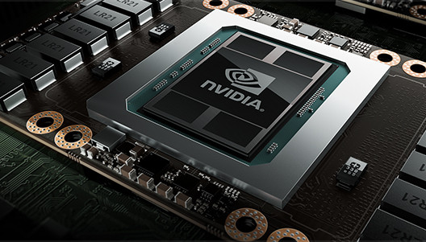
Graphics Processing Unit
Zhenyu Ye
Henk Corporaal
5SIA0, TU/e, 2015
Background image: Nvidia Tesla P100 with Pascal architecture.
Notes:
Info of NVIDIA Tesla P100 system:
http://www.nvidia.com/object/tesla-p100.html
White paper on NVIDIA Pascal architecture:
http://www.nvidia.com/object/pascal-architecture-whitepaper.html

Slide 2
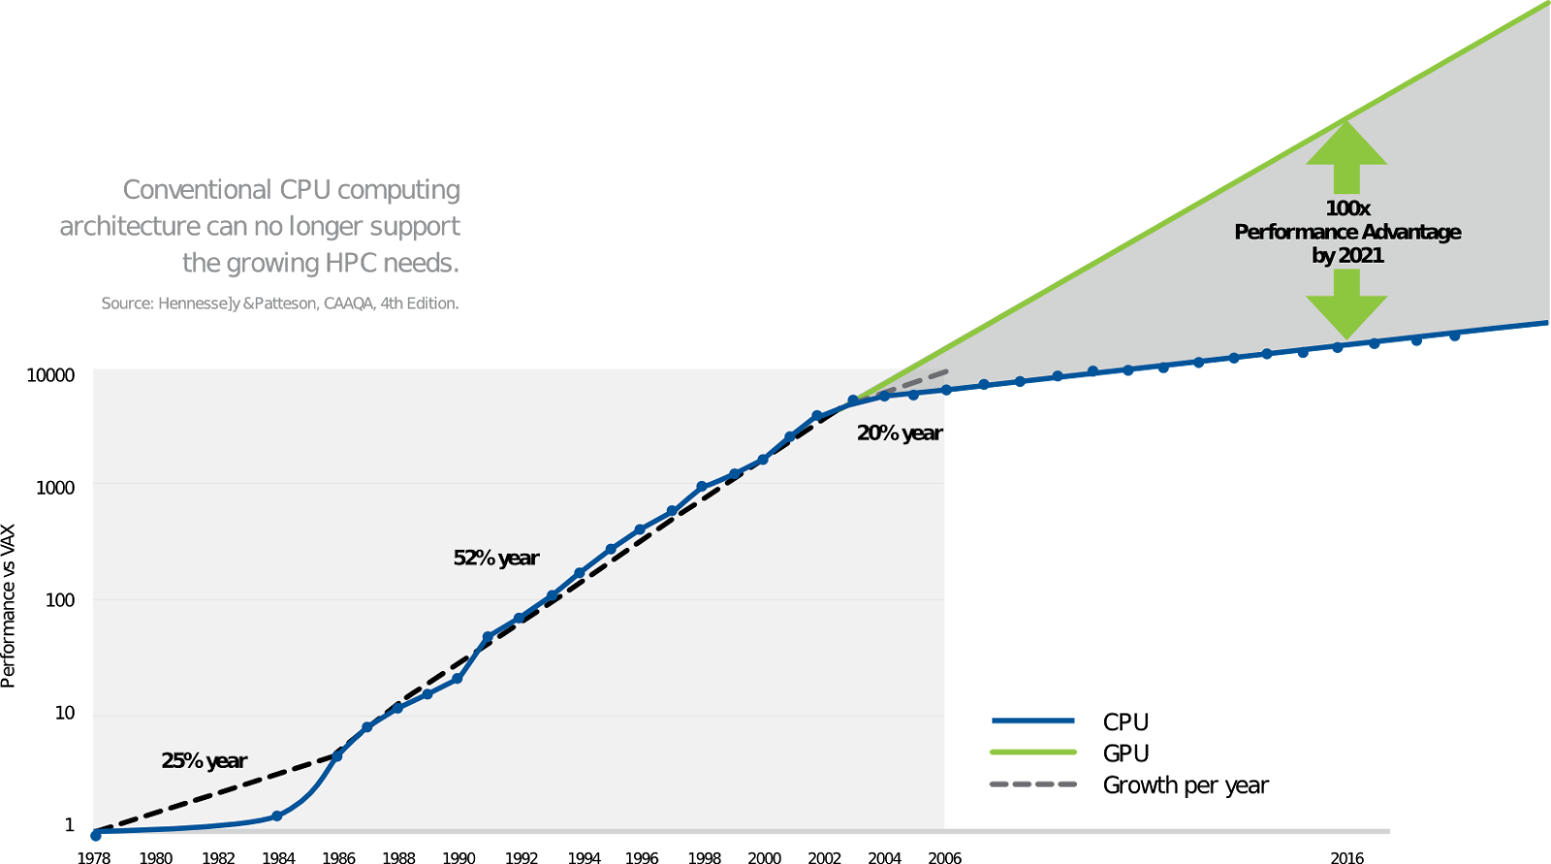
The GPU-CPU Gap (by NVIDIA)
ref: Tesla GPU Computing Brochure
Notes:
Nvidia predicted that the performance gap between CPU and GPU will enlarge in the coming years, to as much as 100 times.

Slide 3
The GPU-CPU Gap (data)
Historical data on 1403 Intel CPUs (left) and 566 NVIDIA GPUs (right).
Reference: Figure 2.3 and 2.4 in the PhD thesis of Cedric Nugteren, TU/e, 2014.
“Improving the Progammability of GPU Architectures”
http://repository.tue.nl/771987
Notes:
According to the data, the GPU-CPU gap does exist, but smaller than predicted, if the vector performance of CPUs is considered.

Slide 4
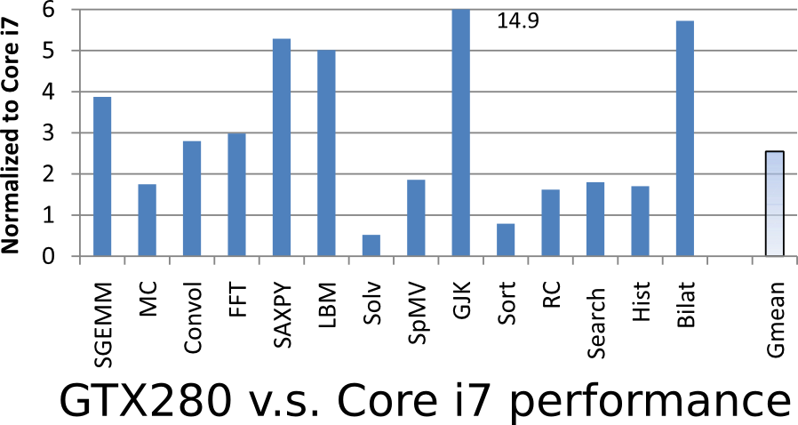
The GPU-CPU Gap (by Intel)
ref: "Debunking the 100X GPU vs. CPU myth", http://dx.doi.org/10.1145/1815961.1816021
Notes:
When measured by benchmarks performance instead of peak performance, the GPU-CPU gap is much smaller, especially for irregular applications.

Slide 5
In This Lecture, We Will Find Out
The architecture of GPUs
Single Instruction Multiple Thread
Memory hierarchy
The program model of GPUs
The threading hierarchy
Memory space
Notes:
The architecture and programming model are tightly coupled, and therefore discussed together throughout this lecture.

Slide 6
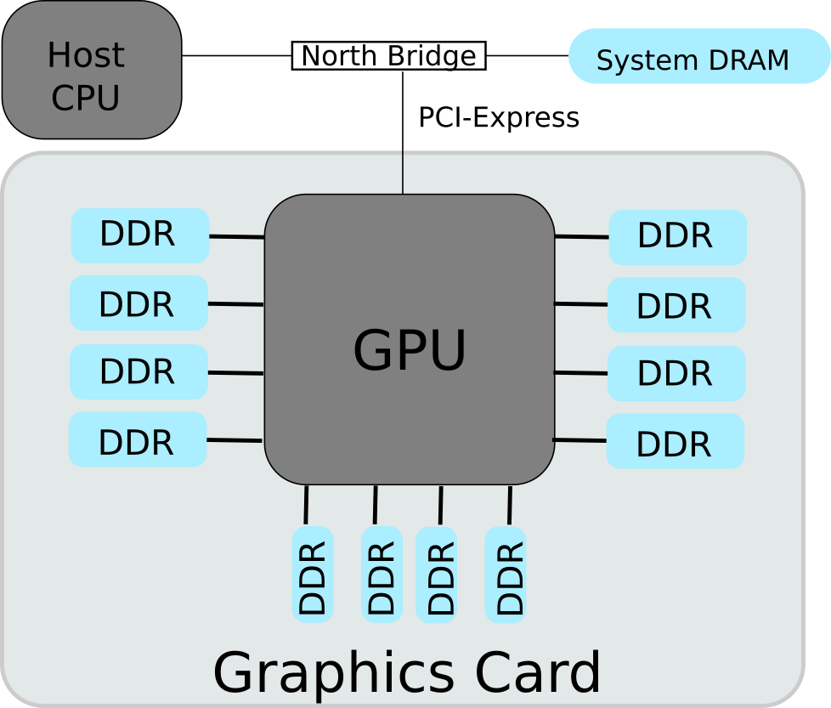
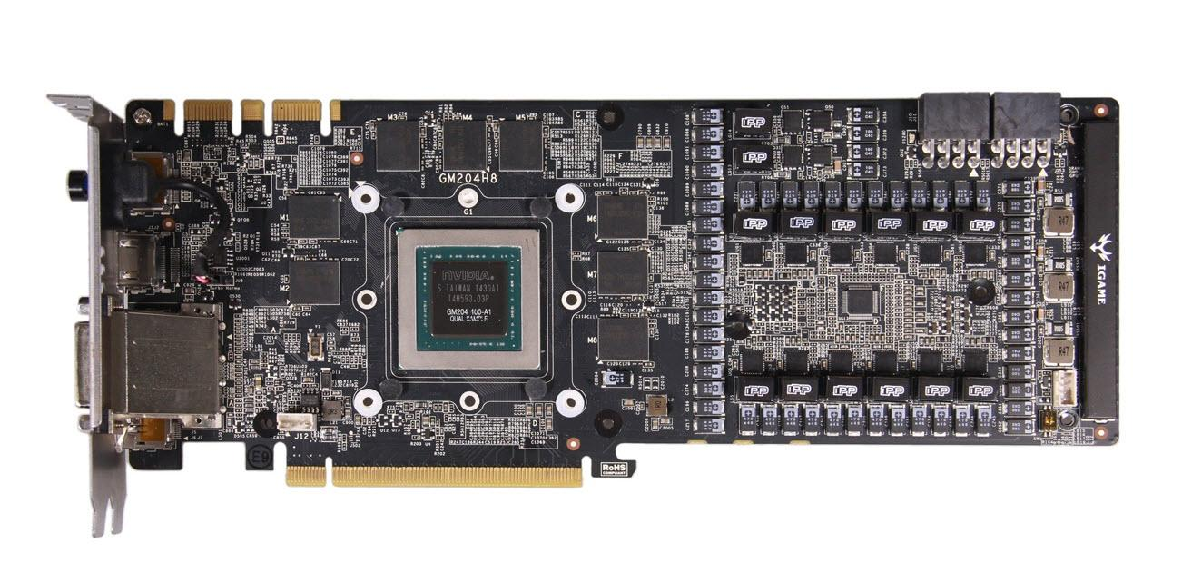
GPU in Graphics Card
Image: Nvidia GTX 980
Notes:
The number of Graphics DDR (GDDR) memory varies by configuration. The North Bridge and the GPU are now often integrated into the CPU die.

Slide 7
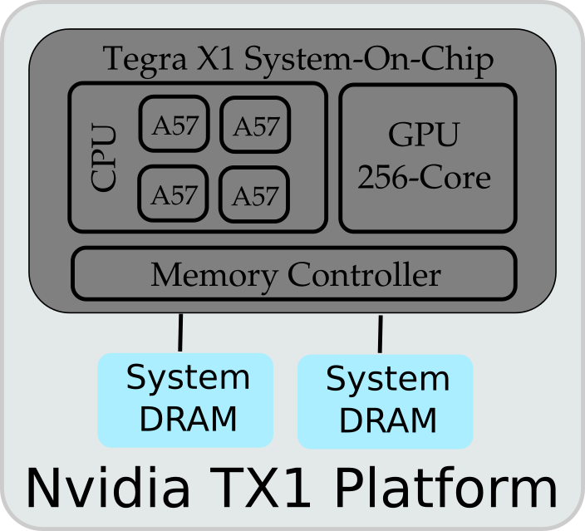
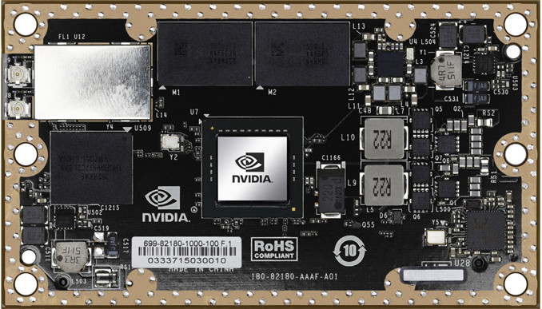
GPU in Mobile Processors
Image: Nvidia Jetson TX1 (Tegra X1 SOC)
Notes:
On the left is the Nvidia Jetson JX1 Development platform, which contains the Nvidia Tegra X1 System-On-Chip (SOC) with integrated GPU.
On the right is the an overview of major components in the platform and SOC.
Compared to the GPUs in discrete graphics card, the GPU in mobile SOC is tightly integrated with the CPU, sharing on-chip network and off-chip memory.
Reference:
https://devblogs.nvidia.com/parallelforall/nvidia-jetson-tx1-supercomputer-on-module-drives-next-wave-of-autonomous-machines/

Slide 8
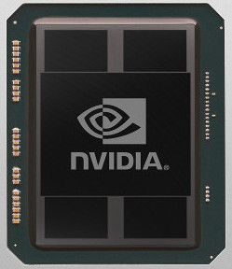
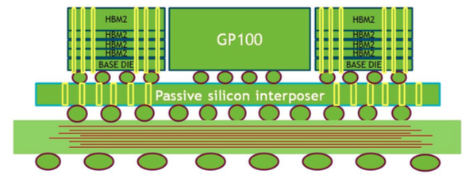
GPU in High-Performance Computers
Image: Nvidia P100
(Pascal Architecture)
Chip-on-Wafer-on-Substrate
Notes:
On the top left is the Nvidia P100 chip, designed for high-performance computing.
At the bottom is the mechanism of Chip-on-Wafer-on-Substrate, which integrates the GPU with stacked DDR memories on the same substrate.
On the top right is one possible configuration of multiple GPUs with one CPU.
Details of the Pascal architecture are available in this whitepaper:
https://images.nvidia.com/content/pdf/tesla/whitepaper/pascal-architecture-whitepaper.pdf

Slide 9
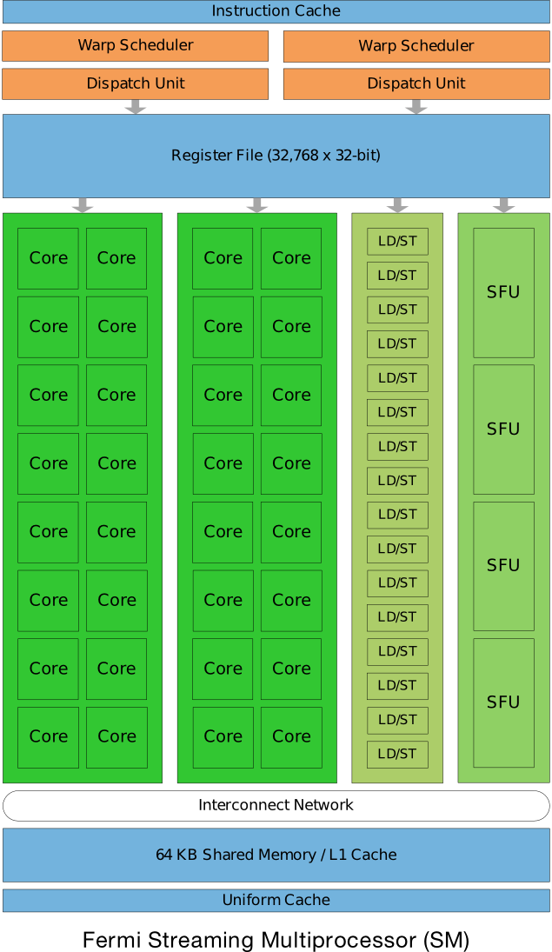
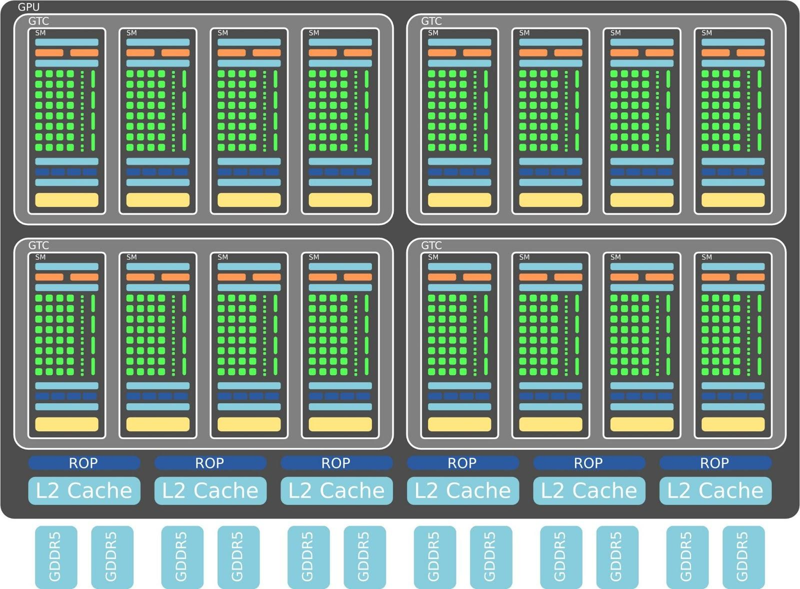
NVIDIA (Fermi Arch.)
ref: http://www.nvidia.com/content/PDF/fermi_white_papers/NVIDIA_Fermi_Compute_Architecture_Whitepaper.pdf
Notes:
NVIDIA Fermi architecture can scale to 512 Cores, also called Processing Elements (PEs), although low-end versions are configured with less PEs.
In the context of this lecture, and related documents, these three terms are equivalent and interchangeable:
Processing Element (PE)
Stream Processor (SP)
Core

Slide 10
Transistor Count
ref: http://en.wikipedia.org/wiki/Transistor_count
Multicore
Manycore
SOC
Processor | Transistor | Tech. Node
61-Core Xeon Phi | 5,000,000,000 | 22nm
22-core Xeon Broadwell-E5 | 7,200,000,000 | 14nm
32-Core Sparc M7 | 10,000,000,000+ | 20nm
GPU
Processor | Transistor | Tech. Node
Nvidia GP00 Pascal | 15,300,000,000 | 16nm
FPGA | Transistor | Tech. Node
Virtex-Ultrascale XCVU440 | 20,000,000,000+ | 20nm
Stratix 10 10GX5500 | 30,000,000,000+ | 14nm
FPGA
Notes:
The Xilinx Ultrascale architecture stacks multiple dies into a silicon interposer. The 20bn transistors is on a multi-die “2.5D” chip (http://www.xilinx.com/publications/archives/xcell/Xcell86.pdf)

Slide 11
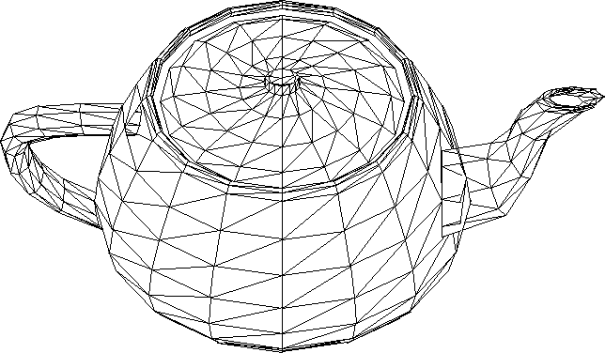
What Can 15bn Transistors Do?
Render triangles.
Billions of triangles per second.
ref: "How GPUs Work", http://dx.doi.org/10.1109/MC.2007.59
Notes:
The image is the Utah teapot (http://en.wikipedia.org/wiki/Utah_teapot).

Slide 12
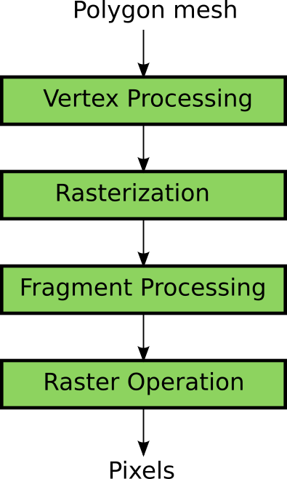
The Graphics Pipeline
K. Fatahalian, et al. "GPUs: a Closer Look", ACM Queue 2008, http://doi.acm.org/10.1145/1365490.1365498
Notes:
A graphics pipeline takes 3D models represented as polygon meshes, and renders the models according the view point of the current frame.
This example only shows basic steps of a graphics pipeline. Modern graphics pipelines are more complicated.

Slide 13
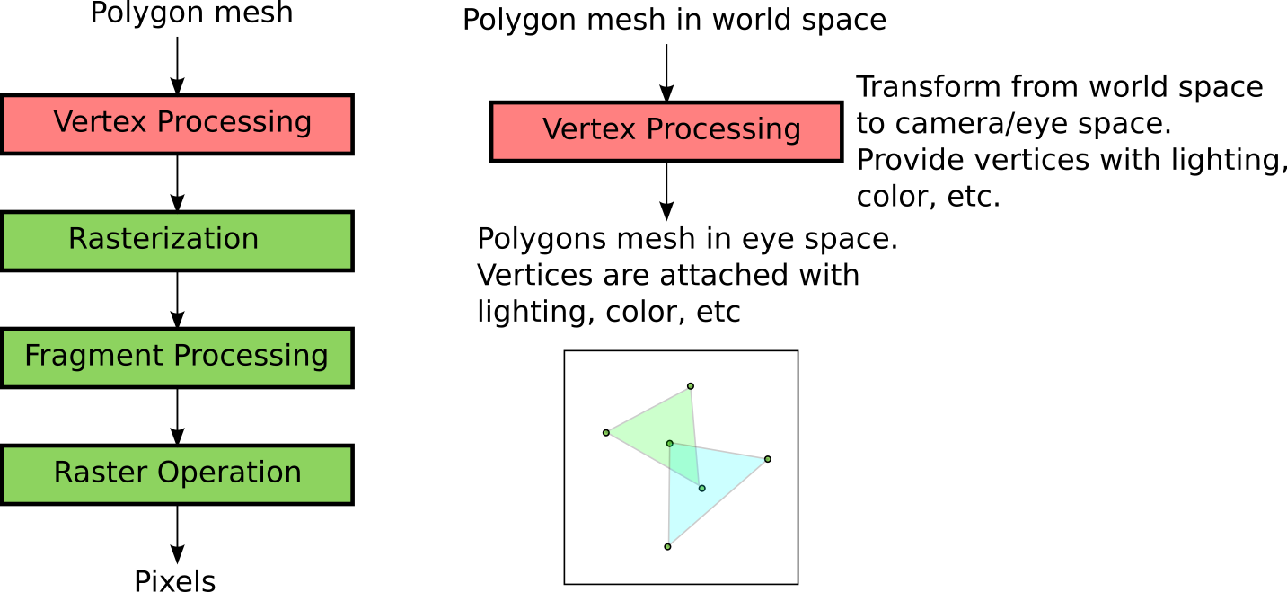
The Graphics Pipeline
K. Fatahalian, et al. "GPUs: a Closer Look", ACM Queue 2008, http://doi.acm.org/10.1145/1365490.1365498
Notes:
The vertex processing takes the polygons from the world space, and transform their coordinates according to the view point of the current frame.
The properties of the vertex, like lighting and color, will be computed.

Slide 14
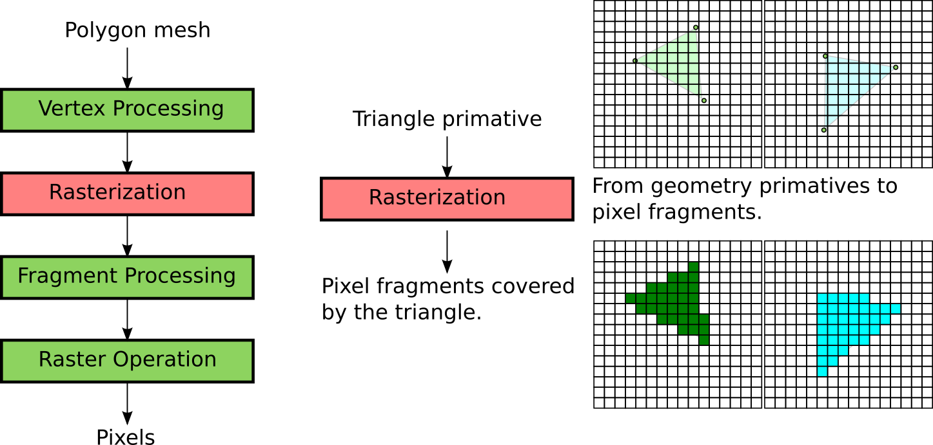
The Graphics Pipeline
K. Fatahalian, et al. "GPUs: a Closer Look", ACM Queue 2008, http://doi.acm.org/10.1145/1365490.1365498
Notes:
The rasterization calculates the pixels that are covered by the triangle (or polygon).

Slide 15
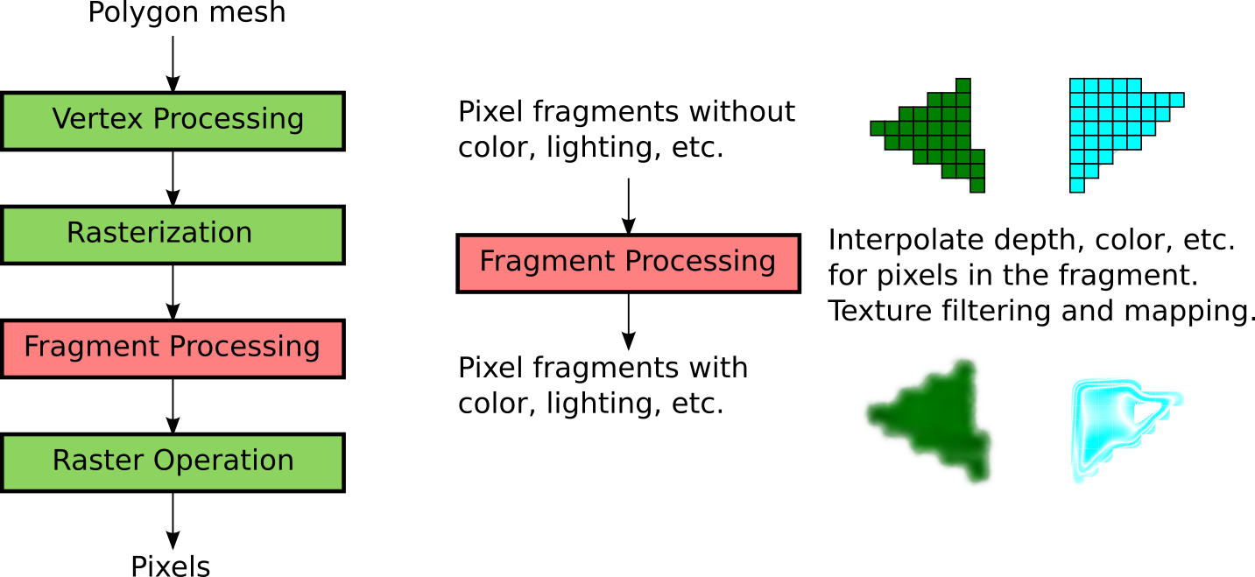
The Graphics Pipeline
K. Fatahalian, et al. "GPUs: a Closer Look", ACM Queue 2008, http://doi.acm.org/10.1145/1365490.1365498
Notes:
The fragment processing derives the properties of each pixel, like depth and color, from the properties of the vertex.
The pixel fragment will also be attached with textures, which is part of the input model in the graphics pipeline.

Slide 16
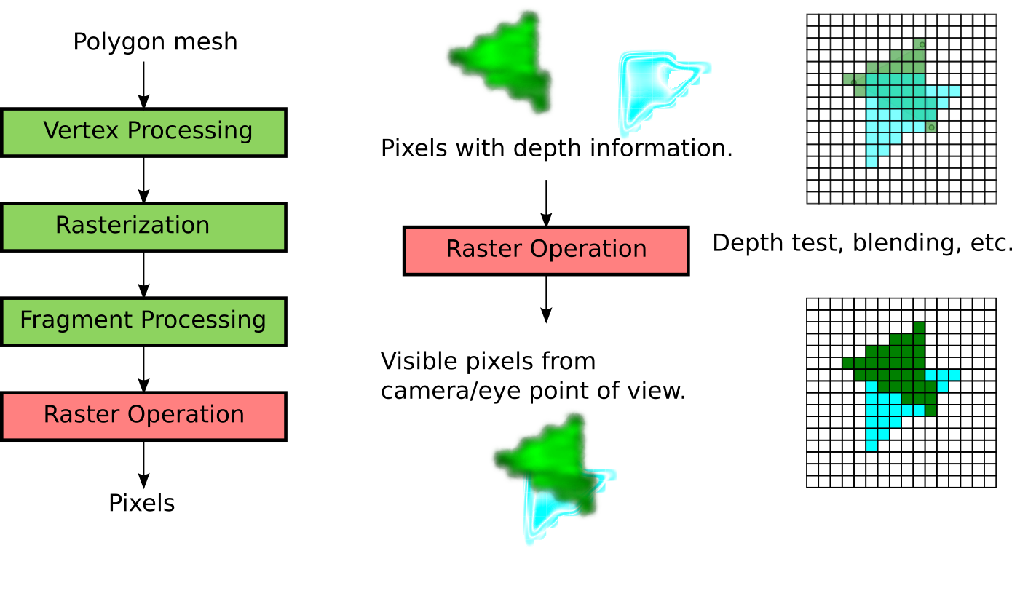
The Graphics Pipeline
K. Fatahalian, et al. "GPUs: a Closer Look", ACM Queue 2008, http://doi.acm.org/10.1145/1365490.1365498
Notes:
The pixel fragments of different polygons are having different depths.
A pixel fragment may be (partially) occluded by another pixel fragment.
It will to be resolved by the raster operation.

Slide 17
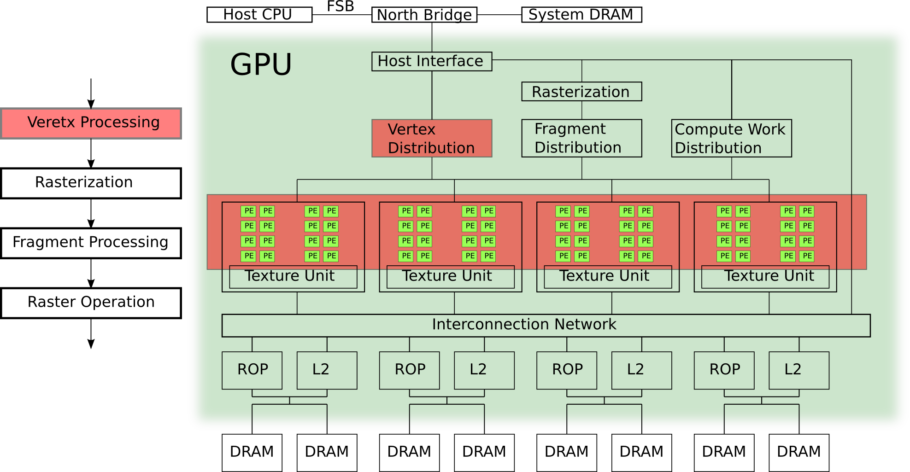
Graphics Pipeline on GPU
Notes:
Vertex processing is mainly done on the programmable cores, with the help of some dedicated hardware.

Slide 18
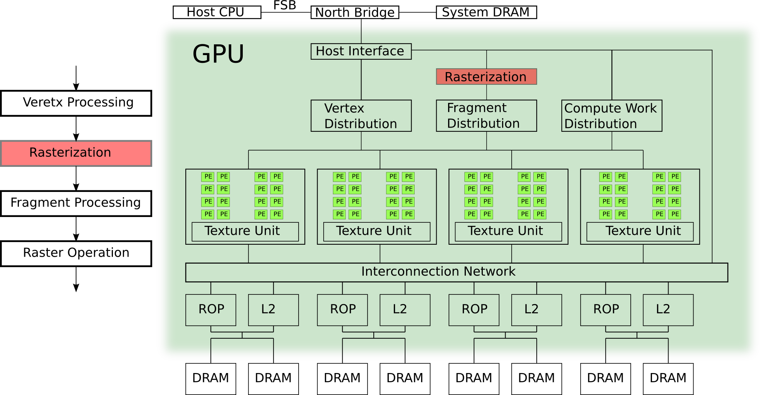
Graphics Pipeline on GPU
Notes:
The rasterization can be performed by dedicated hardware.

Slide 19
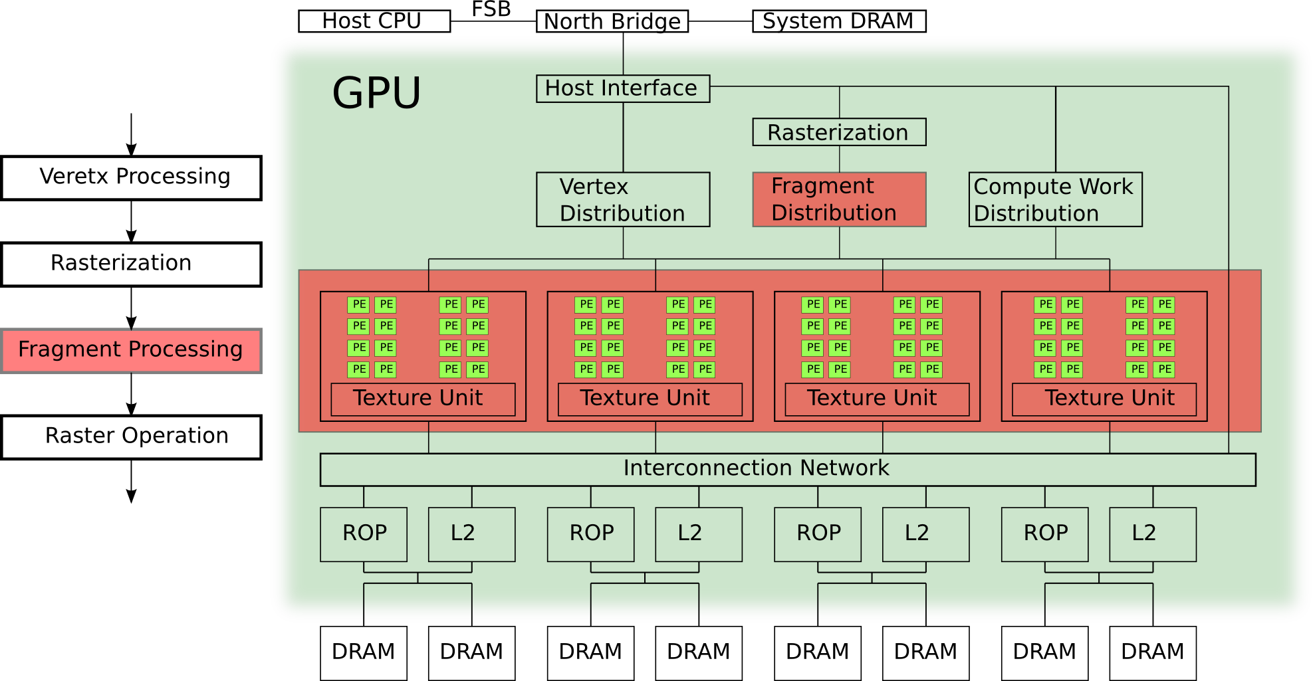
Graphics Pipeline on GPU
Notes:
The fragment processing is done by the programmable processor, with the help of texture unit, which performs texture fetch and filtering.

Slide 20
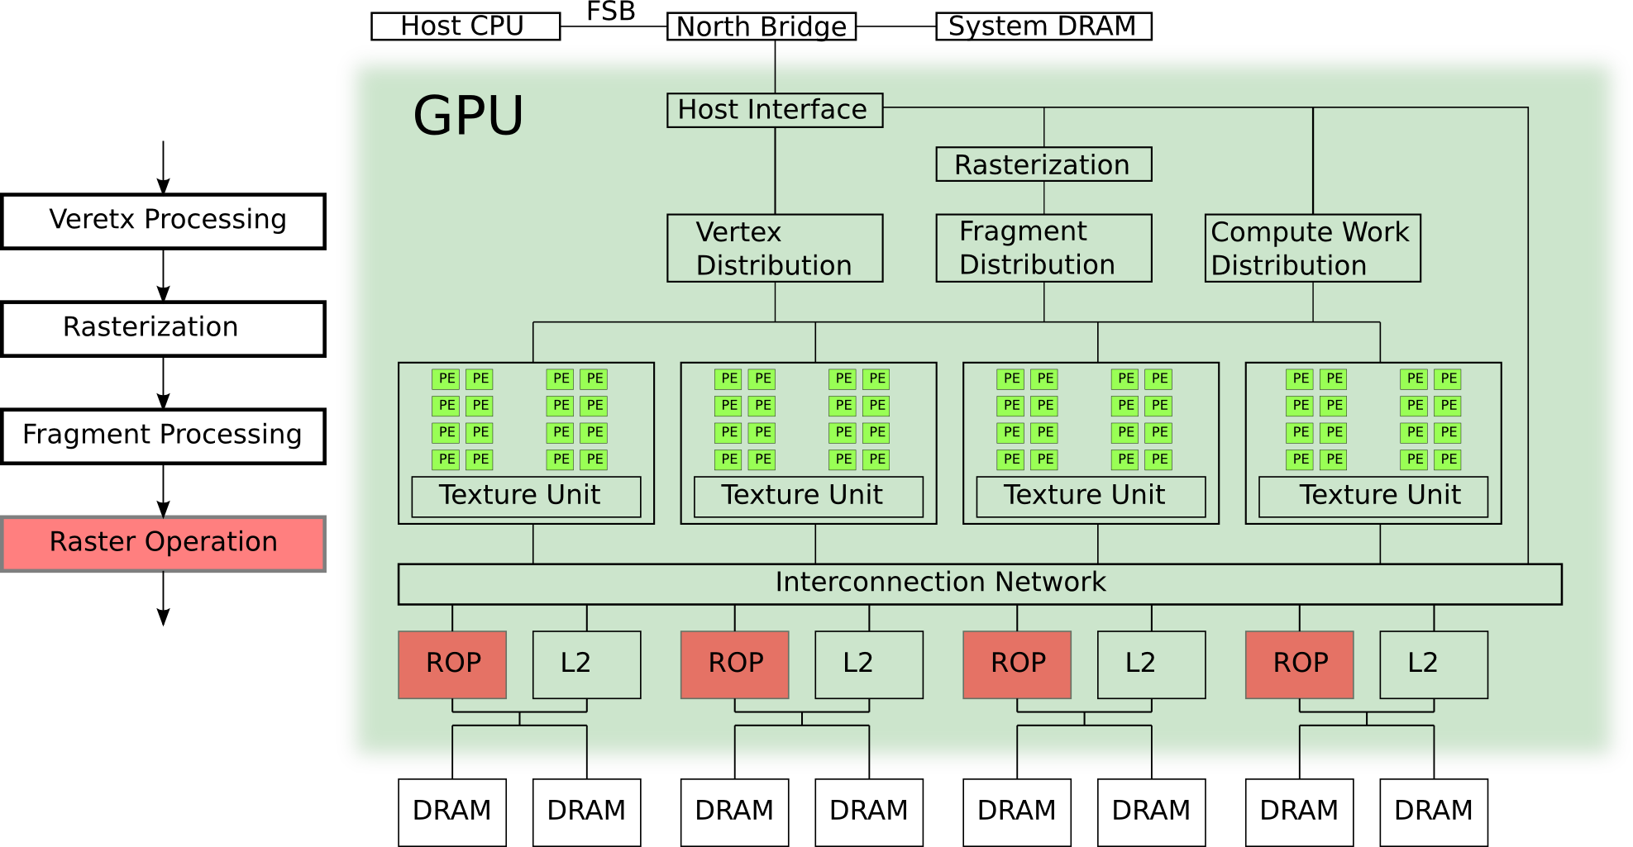
Graphics Pipeline on GPU
Notes:
The raster operation is mainly done by dedicated hardware, called the Raster Operation Unit (ROP).
GPU typically has a depth buffer, which performs bookkeeping for the depth of each pixel of the frame.
When a new pixel fragment is to be stored to the frame buffer, the ROP will compare its depth against the depth buffer.
If the depth of the new pixel is closer to the view point, the new pixel will be drawn to the frame, and the depth buffer will be updated with its depth.
Otherwise, the new pixel is occluded by existing pixels, and will not be drawn to the frame buffer.

Slide 21
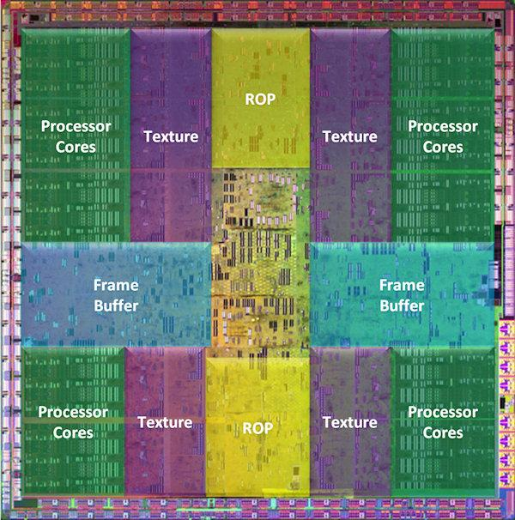
How Do GPUs Spend Their Die Area?
GPUs are designed to match the workload of 3D graphics.
Die photo of GeForce GTX 280 (source: NVIDIA)
Texture:
For fragment processing.
ROP & Frame Buffer:
For raster operation.
J. Roca, et al. "Workload Characterization of 3D Games", IISWC 2006, link
T. Mitra, et al. "Dynamic 3D Graphics Workload Characterization and the Architectural Implications", Micro 1999, link

Slide 22
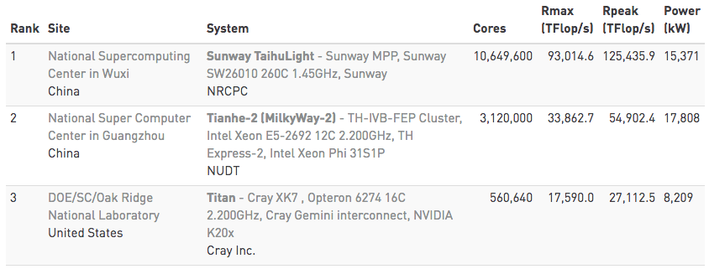
GPUs Besides Graphics
TOP500 supercomputer list in Nov. 2016. (http://www.top500.org)
Notes:
The No. 3 in the list utilizes GPUs.
Rpeak: peak theoretical performance
Rmax: maximum application performance, benchmarked using LINPACK.

Slide 23
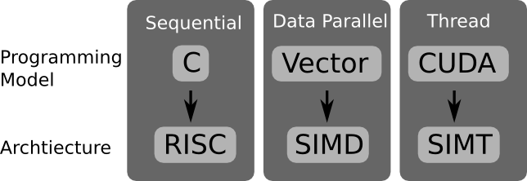
Let's Start with Examples
We will start from C and RISC.
Notes:
The programming model is not necessarily coupled to the architecture. For example, the vector programming model can be mapped to RISC architecture.
This lecture chooses to map the aforementioned programming models to the architectures that are most suitable.

Slide 24
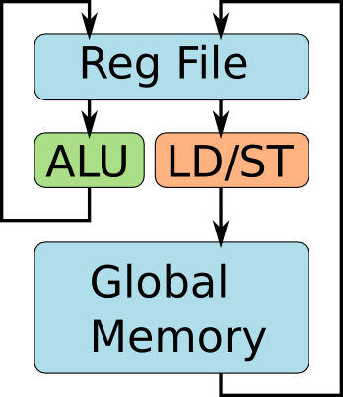
Let's Start with C and RISC
int A[2][4];
for(i=0;i<2;i++){
for(j=0;j<4;j++){
A[i][j]++;
}
}
Assembly
code of
inner-loop
lw r0, 4(r1)
addi r0, r0, 1
sw r0, 4(r1)
Programmer's view of RISC
Notes:
To process an array of elements, a typical C program will use loop nests.
The programmers see a global memory space. The memory hierarchy, with multiple levels of caches, is transparent to programmers.

Slide 25
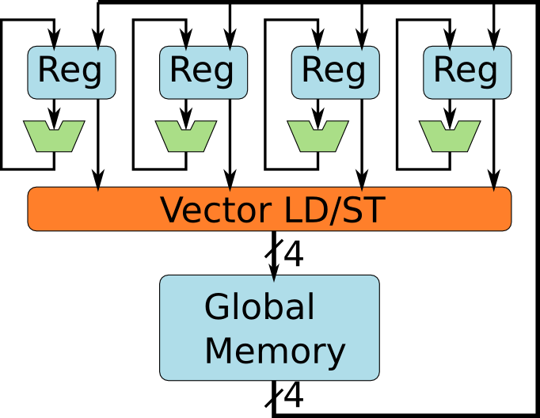
Most CPUs Have Vector SIMD Units
Programmer's view of a vector SIMD, e.g. SSE.
Notes:
The Intel Streaming SIMD Extension (SSE) starts with 4 data lanes. It later evolves to the Advanced Vector Extensions (AVX) of 16 data lanes and higher. This lecture assumes 4 data lanes for the sake of simplicity.

Slide 26
Let's Program the Vector SIMD
Unroll inner-loop to vector operation.
int A[2][4];
for(i=0;i<2;i++){
for(j=0;j<4;j++){
A[i][j]++;
}
}
int A[2][4];
for(i=0;i<2;i++){
movups xmm0, [ &A[i][0] ] // load
addps xmm0, xmm1 // add 1
movups [ &A[i][0] ], xmm0 // store
}
Looks like the previous example,
but each SSE instruction executes on 4 ALUs.
Notes:
One inner loop of 4 interactions can be exactly unrolled into a vector of 4 elements. Note that the programmers need to know the width of the SIMD.

Slide 27
How Do Vector Programs Run?
int A[2][4];
for(i=0;i<2;i++){
movups xmm0, [ &A[i][0] ] // load
addps xmm0, xmm1 // add 1
movups [ &A[i][0] ], xmm0 // store
}
Notes:
There are three major steps:
Loading a vector of four elements (red rectangles in the figure) from global memory to vector register.
Perform the vector computation using the vector register.
Store the resulted vector into the global memory.

Slide 28
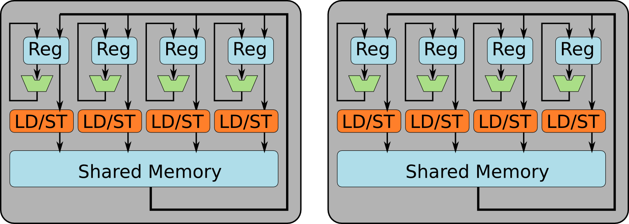
CUDA Programmer's View of GPUs
A GPU contains multiple SIMD Units.
Notes:
The GPU consists of multiple SIMD-like clusters. Each cluster has its own local memory, shared by the four PEs within the SIMD cluster. Therefore, the local memory is also called shared memory.
For the sake of simplicity, two SIMD clusters are illustrated. The SIMD cluster of Nvidia GPUs is actually different than the SIMD in CPUs. These differences will be discussed later in the lecture.

Slide 29
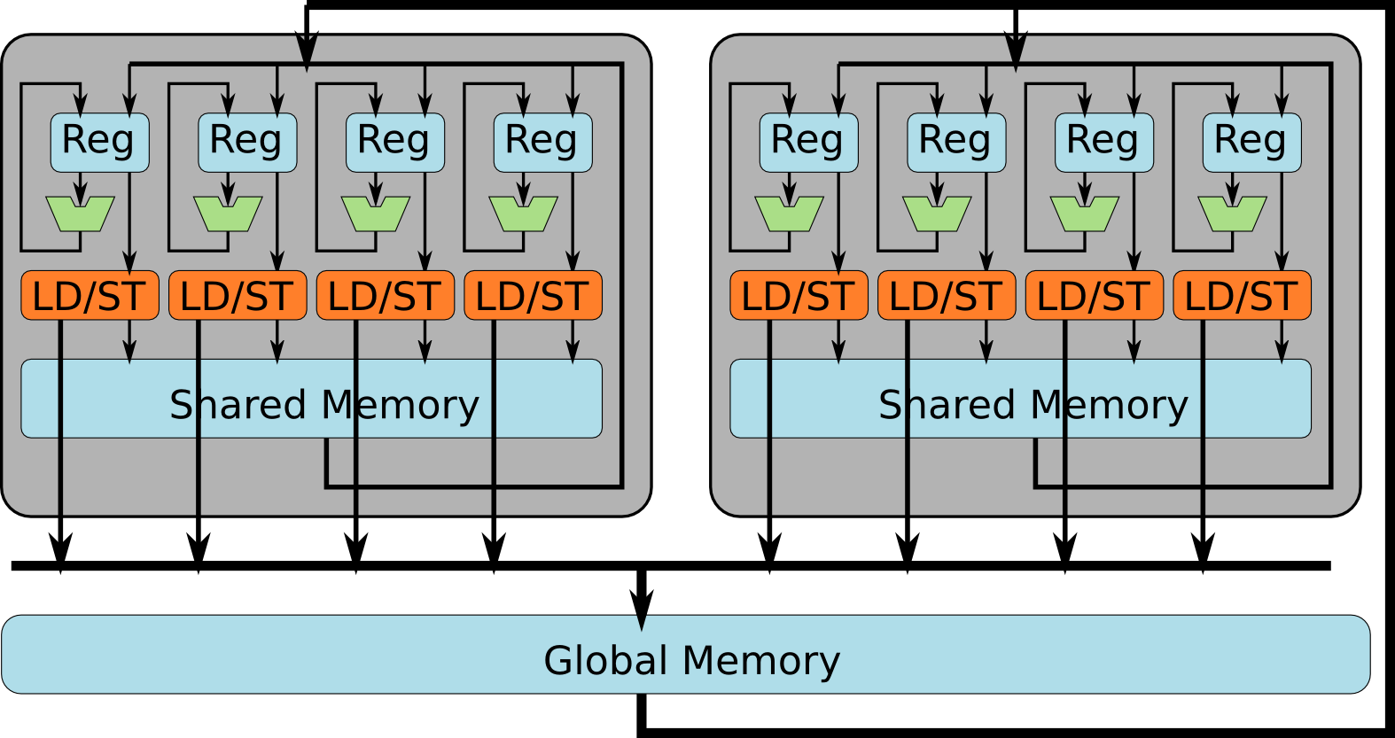
CUDA Programmer's View of GPUs
A GPU contains multiple SIMD Units. All of them can access global memory.
Notes:
The GPU typically has multiple levels of memory hierarchy that are exposed to the programming model. Two most important memory spaces are the shared memory space and the global memory space.
Shared memory: shared among the PEs within a cluster. Cluster 2 cannot access the shared memory in cluster 1, and vice vesa.
Global memory: any PE from any cluster can access the data in global memory.
There are more subtle difference between these two memories, mostly related to the threading hierarchy, which will be discussed later.

Slide 30
What Are the Differences?
SSE
GPU
Let's start with two important differences:
GPUs use threads instead of vectors
GPUs have the "Shared Memory" spaces
Notes:
The threading programming model and its architectural support is a fundamental difference between modern GPUs and CPUs. Although OpenCL (and, theoretically, CUDA) can also run on SSE, the SSE lacks the architectural support for the threading programming model.
The explicit managed shared memory space is not a fundamental difference, because many SIMD processors have an explicitly managed local memory. For the sake of consistency, we stick to the example of SSE, and therefore the shared memory space is considered as a difference.

Slide 31
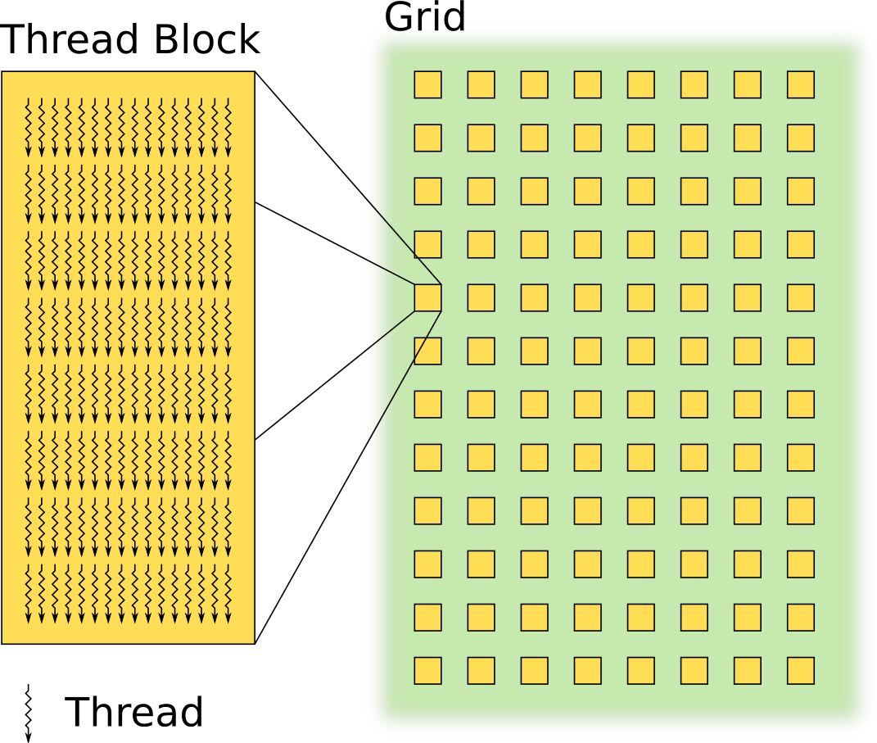
Thread Hierarchy in CUDA
Grid
contains
Thread Blocks
Thread Block
contains
Threads
Notes:
To keep thousands of PEs busy, programmers need to create a massive number of threads, at the scales of millions and beyond.
To organize millions of threads, hierarchy is imposed.
Hundreds of threads are grouped into a thread block.
Tens to thousands of threads block are grouped into a grid.

Slide 32
Let's Start Again from C
int A[2][4];
for(i=0;i<2;i++)
for(j=0;j<4;j++)
A[i][j]++;
convert into CUDA
int A[2][4];
kernelF<<<(2,1),(4,1)>>>(A);
__device__ kernelF(A){
i = blockIdx.x;
j = threadIdx.x;
A[i][j]++;
}
// define 2x4=8 threads
// all threads run same kernel
// each thread block has its id
// each thread has its id
// each thread has different i and j
Notes:
Programmers explicitly express the available parallelism into threads. In this example, there are two thread blocks, each with four threads.

Slide 33
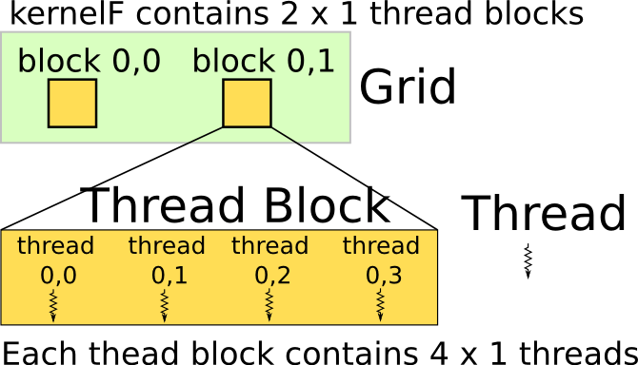
Thread Hierarchy
Example:
thread 3 of block 1 operates
on element A[1][3]
int A[2][4];
kernelF<<<(2,1),(4,1)>>>(A);
__device__ kernelF(A){
i = blockIdx.x;
j = threadIdx.x;
A[i][j]++;
}
// define 2x4=8 threads
// all threads run same kernel
// each thread block has its id
// each thread has its id
// each thread has different i and j
Notes:
The syntax of declaring the thread hierarchy is <<<(a,b,c),(d,e,f)>>>, in which
a,b,c are the three dimensions of the grid, which has (a*b*c) blocks
d,e,f, are the three dimensions of the block, which has (d*e*f) threads
If the a dimension is not specified, the default size of that dimension is one.

Slide 34
How Are Threads Scheduled?
Notes:
Each thread block can only run on one SIMD cluster.
Threads within the same thread block can share data via the same shared memory.
Threads in different blocks can only share data via global memory.

Slide 35
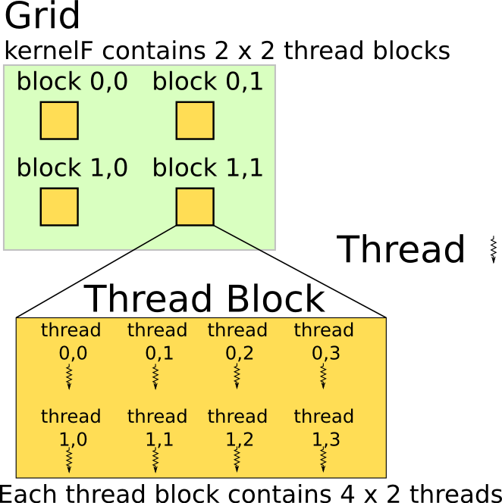
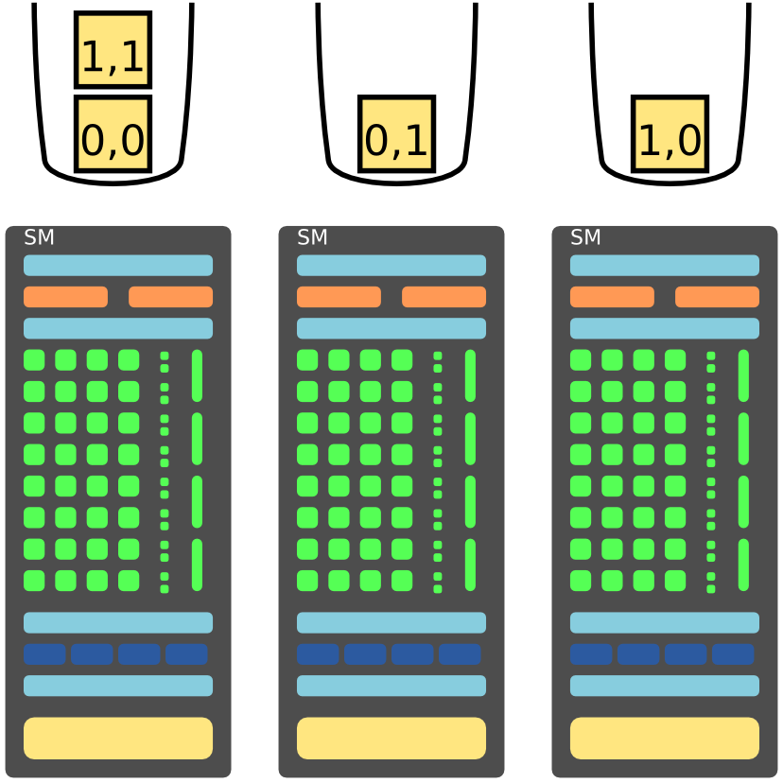
Blocks Are Dynamically Scheduled
Notes:
Thread blocks are scheduled to the SIMD clusters dynamically.

Slide 36
How Are Threads Executed?
int A[2][4];
kernelF<<<(2,1),(4,1)>>>(A);
__device__ kernelF(A){
i = blockIdx.x;
j = threadIdx.x;
A[i][j]++;
}
mv.u32 %r0, %ctaid.x
mv.u32 %r1, %ntid.x
mv.u32 %r2, %tid.x
mad.u32 %r3, %r2, %r1, %r0
ld.global.s32 %r4, [%r3]
add.s32 %r4, %r4, 1
st.global.s32 [%r3], %r4
// r0 = i = blockIdx.x
// r1 = "threads-per-block"
// r2 = j = threadIdx.x
// r3 = i * "threads-per-block" + j
// r4 = A[i][j]
// r4 = r4 + 1
// A[i][j] = r4
Notes:
The assembly code shown here is similar to the syntax of Nvidia Parallel Thread Execution (PTX) virtual machine ISA:
http://docs.nvidia.com/cuda/parallel-thread-execution/
For the sake of simplicity, the code here does not follow the exact syntax of PTX.

Slide 37
Utilizing Memory Hierarchy
Memory
access
latency
several cycles
100+ cycles
Notes:
Access to shared memory takes a few cycles of delay, which can be hidden by multithreading. Moreover, the shared memory has multiple banks to improve bandwidth.
Access to global memory takes hundreds of cycles, because it is off-chip. Moreover, the bandwidth of global memory is two orders of magnitude smaller than shared memory.

Slide 38
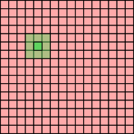
Example: Average Filters
Average over a
3x3 window for
a 16x16 array
kernelF<<<(1,1),(16,16)>>>(A);
__device__ kernelF(A){
i = threadIdx.y;
j = threadIdx.x;
tmp = (A[i-1][j-1] + A[i-1][j] +
… + A[i+1][i+1] ) / 9;
A[i][j] = tmp;
}
Each thread loads 9 elements
from global memory.
It takes hundreds of cycles.
Notes:
The bottlenecks are two folded:
It is bandwidth bound. For every byte loaded from off-chip memory, too few operations are performed. The computation to (off-chip) memory ration if too low. The PEs are therefore starved for data most of the time.
It is also latency bound. Even if the off-chip memory bandwidth is infinite, the latency of the off-chip access requires thousands of active threads to hide, which is hard to maintain.

Slide 39
Utilizing the Shared Memory
kernelF<<<(1,1),(16,16)>>>(A);
__device__ kernelF(A){
__shared__ smem[16][16];
i = threadIdx.y;
j = threadIdx.x;
smem[i][j] = A[i][j]; // load to smem
A[i][j] = ( smem[i-1][j-1] + smem[i-1][j] +
… + smem[i+1][i+1] ) / 9;
}
Average over a
3x3 window for
a 16x16 array
Notes:
Programmers can declare a variable or an array as located in the shared memory, using the “__shared__” intrinsics.

Slide 40
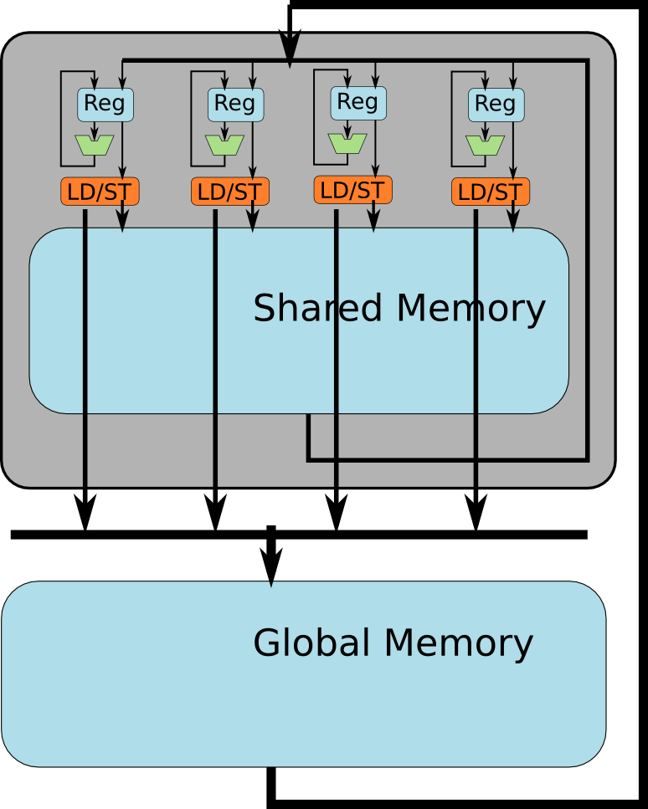
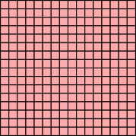
Utilizing the Shared Memory
kernelF<<<(1,1),(16,16)>>>(A);
__device__ kernelF(A){
__shared__ smem[16][16];
i = threadIdx.y;
j = threadIdx.x;
smem[i][j] = A[i][j]; // load to smem
A[i][j] = ( smem[i-1][j-1] + smem[i-1][j] +
… + smem[i+1][i+1] ) / 9;
}
allocate
shared
mem
Each thread loads one element from global memory.
Notes:
There are three major steps:
each of the 16x16 threads loads 1 element from global memory to shared memory
each thread compute over a 3x3 window using shared memory
each thread store its result of window operation into the global memory
Now the computation to (off-chip) memory ratio is 9:2 (assuming 8-bit data, eight addition, one division, one read, one write).

Slide 41
However, the Program Is Incorrect
kernelF<<<(1,1),(16,16)>>>(A);
__device__ kernelF(A){
__shared__ smem[16][16];
i = threadIdx.y;
j = threadIdx.x;
smem[i][j] = A[i][j]; // load to smem
A[i][j] = ( smem[i-1][j-1] + smem[i-1][j] +
… + smem[i+1][i+1] ) / 9;
}
Hazards!
Notes:
As in all threaded programs, there are race hazards. Let’s debug the program step by step.

Slide 42
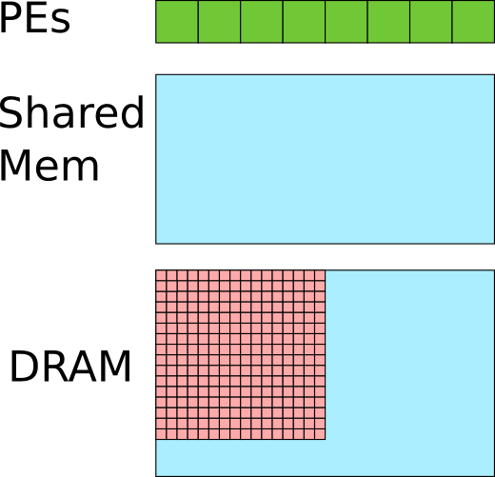
Let's See What's Wrong
Assume 256 threads are scheduled on 8 PEs.
kernelF<<<(1,1),(16,16)>>>(A);
__device__ kernelF(A){
__shared__ smem[16][16];
i = threadIdx.y;
j = threadIdx.x;
smem[i][j] = A[i][j]; // load to smem
A[i][j] = ( smem[i-1][j-1] + smem[i-1][j] +
… + smem[i+1][i+1] ) / 9;
}
Before load instruction
Notes:
Before the load instruction, all the 16x16 elements are in the global memory.

Slide 43
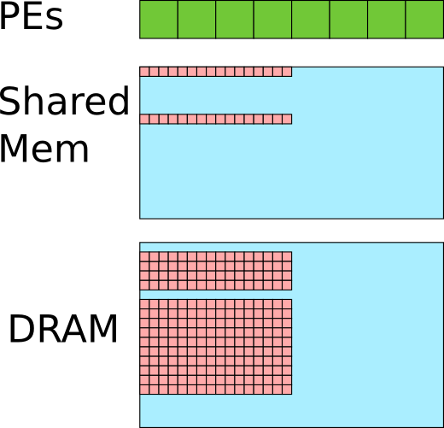
Let's See What's Wrong
Assume 256 threads are scheduled on 8 PEs.
kernelF<<<(1,1),(16,16)>>>(A);
__device__ kernelF(A){
__shared__ smem[16][16];
i = threadIdx.y;
j = threadIdx.x;
smem[i][j] = A[i][j]; // load to smem
A[i][j] = ( smem[i-1][j-1] + smem[i-1][j] +
… + smem[i+1][i+1] ) / 9;
}
Some threads finish the load earlier than others.
Notes:
Now some threads loads the data to shared memory ahead of other threads, because threads are executed out of order.

Slide 44
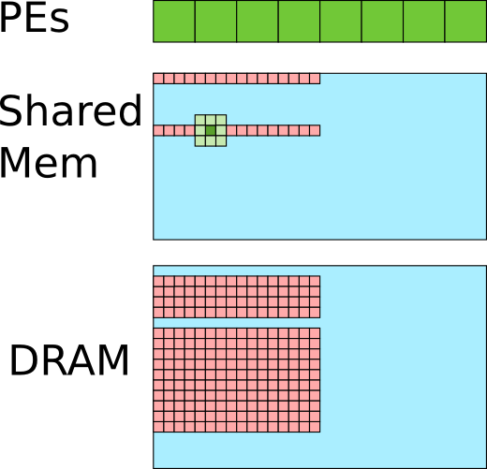
Let's See What's Wrong
Assume 256 threads are scheduled on 8 PEs.
kernelF<<<(1,1),(16,16)>>>(A);
__device__ kernelF(A){
__shared__ smem[16][16];
i = threadIdx.y;
j = threadIdx.x;
smem[i][j] = A[i][j]; // load to smem
A[i][j] = ( smem[i-1][j-1] + smem[i-1][j] +
… + smem[i+1][i+1] ) / 9;
}
Some elements in the window are not yet loaded by other threads. Error!
Notes:
Some threads start execute the window operation before other threads finish loading the data to shared memory. Therefore, the window operation operates on faulty data.

Slide 45
How To Solve It?
Assume 256 threads are scheduled on 8 PEs.
kernelF<<<(1,1),(16,16)>>>(A);
__device__ kernelF(A){
__shared__ smem[16][16];
i = threadIdx.y;
j = threadIdx.x;
smem[i][j] = A[i][j]; // load to smem
A[i][j] = ( smem[i-1][j-1] + smem[i-1][j] +
… + smem[i+1][i+1] ) / 9;
}
Notes:
How to solve the race condition in threaded program?

Slide 46
Use a "SYNC" barrier
kernelF<<<(1,1),(16,16)>>>(A);
__device__ kernelF(A){
__shared__ smem[16][16];
i = threadIdx.y;
j = threadIdx.x;
smem[i][j] = A[i][j]; // load to smem
__SYNC();
A[i][j] = ( smem[i-1][j-1] + smem[i-1][j] +
… + smem[i+1][i+1] ) / 9;
}
Assume 256 threads are scheduled on 8 PEs.
Notes:
CUDA introduce a “SYNC” barrier, at which all threads within the same thread block will synchronize. Threads cannot advance beyond the SYNC barrier unless all other threads within the same thread block arrive at the SYNC barrier.

Slide 47
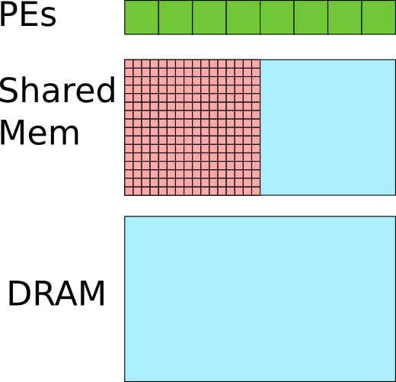
Use a "SYNC" barrier
kernelF<<<(1,1),(16,16)>>>(A);
__device__ kernelF(A){
__shared__ smem[16][16];
i = threadIdx.y;
j = threadIdx.x;
smem[i][j] = A[i][j]; // load to smem
__SYNC();
A[i][j] = ( smem[i-1][j-1] + smem[i-1][j] +
… + smem[i+1][i+1] ) / 9;
}
Assume 256 threads are scheduled on 8 PEs.
Wait until all
threads
hit barrier
Notes:
When all threads hit the SYNC barrier, the 16x16 elements are all loaded to shared memory.

Slide 48
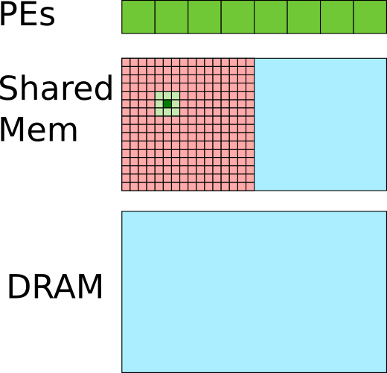
Use a "SYNC" barrier
kernelF<<<(1,1),(16,16)>>>(A);
__device__ kernelF(A){
__shared__ smem[16][16];
i = threadIdx.y;
j = threadIdx.x;
smem[i][j] = A[i][j]; // load to smem
__SYNC();
A[i][j] = ( smem[i-1][j-1] + smem[i-1][j] +
… + smem[i+1][i+1] ) / 9;
}
Assume 256 threads are scheduled on 8 PEs.
All elements in the window are loaded when each thread starts averaging.
Notes:
After the SYNC barrier, the threads does not need to be synchronized any more.

Slide 49
Review What We Have Learned
1. Single Instruction Multiple Thread (SIMT)
2. Shared memory
Q: What are the pros and cons of explicitly managed memory?
Q: What are the fundamental differences between SIMT and vector SIMD programming model?

Slide 50
Take the Same Example Again
Assume vector SIMD and SIMT both have shared memory.
What are the differences?
Average over a
3x3 window for
a 16x16 array
Notes:
As mentioned earlier, the shared memory is not a fundamental difference between vector SIMD and SIMT. We will now look into the fundemental difference.

Slide 51
Vector SIMD v.s. SIMT
int A[16][16]; // A in global memory
__shared__ int B[16][16]; // B in shared mem
for(i=0;i<16;i++){
for(j=0;i<4;j+=4){
movups xmm0, [ &A[i][j] ]
movups [ &B[i][j] ], xmm0 }}
for(i=0;i<16;i++){
for(j=0;i<4;j+=4){
addps xmm1, [ &B[i-1][j-1] ]
addps xmm1, [ &B[i-1][j] ]
… divps xmm1, 9 }}
for(i=0;i<16;i++){
for(j=0;i<4;j+=4){
addps [ &A[i][j] ], xmm1 }}
kernelF<<<(1,1),(16,16)>>>(A);
__device__ kernelF(A){
__shared__ smem[16][16];
i = threadIdx.y;
j = threadIdx.x;
smem[i][j] = A[i][j]; // load to smem
__sync(); // threads wait at barrier
A[i][j] = ( smem[i-1][j-1] + smem[i-1][j] +
… + smem[i+1][i+1] ) / 9;
}
(1)
(1)
(2)
(3)
(2)
(3)
load to shared mem
compute
store to global mem
Notes:
Let’s look at two pieces of code, with vector SIMD code on the left and SIMT code on the right. They both execute the window average example that we have discussed earlier. Both have three major steps, but with differences.

Slide 52
Vector SIMD v.s. SIMT
int A[16][16]; // A in global memory
__shared__ int B[16][16]; // B in shared mem
for(i=0;i<16;i++){
for(j=0;i<4;j+=4){
movups xmm0, [ &A[i][j] ]
movups [ &B[i][j] ], xmm0 }}
for(i=0;i<16;i++){
for(j=0;i<4;j+=4){
addps xmm1, [ &B[i-1][j-1] ]
addps xmm1, [ &B[i-1][j] ]
… divps xmm1, 9 }}
for(i=0;i<16;i++){
for(j=0;i<4;j+=4){
addps [ &A[i][j] ], xmm1 }}
kernelF<<<(1,1),(16,16)>>>(A);
__device__ kernelF(A){
__shared__ smem[16][16];
i = threadIdx.y;
j = threadIdx.x;
smem[i][j] = A[i][j]; // load to smem
__sync(); // threads wait at barrier
A[i][j] = ( smem[i-1][j-1] + smem[i-1][j] +
… + smem[i+1][i+1] ) / 9;
}
(a)
(b)
(c)
(d)
HW vector width explicit to programmer
HW vector width transparent to programmers
each vector executed by all PEs in lock step
threads executed out of order, need explicit sync
Notes:
The difference of (a) and (b) is not a clear cut. There are SIMD programming models that can abstract the HW vector width. That said, between SSE and CUDA, the difference of (a) and (b) is apparent.
The difference of (c) and (d) is more fundamental. Elements in a vector should have the same program state, while threads can have different program states.

Slide 53
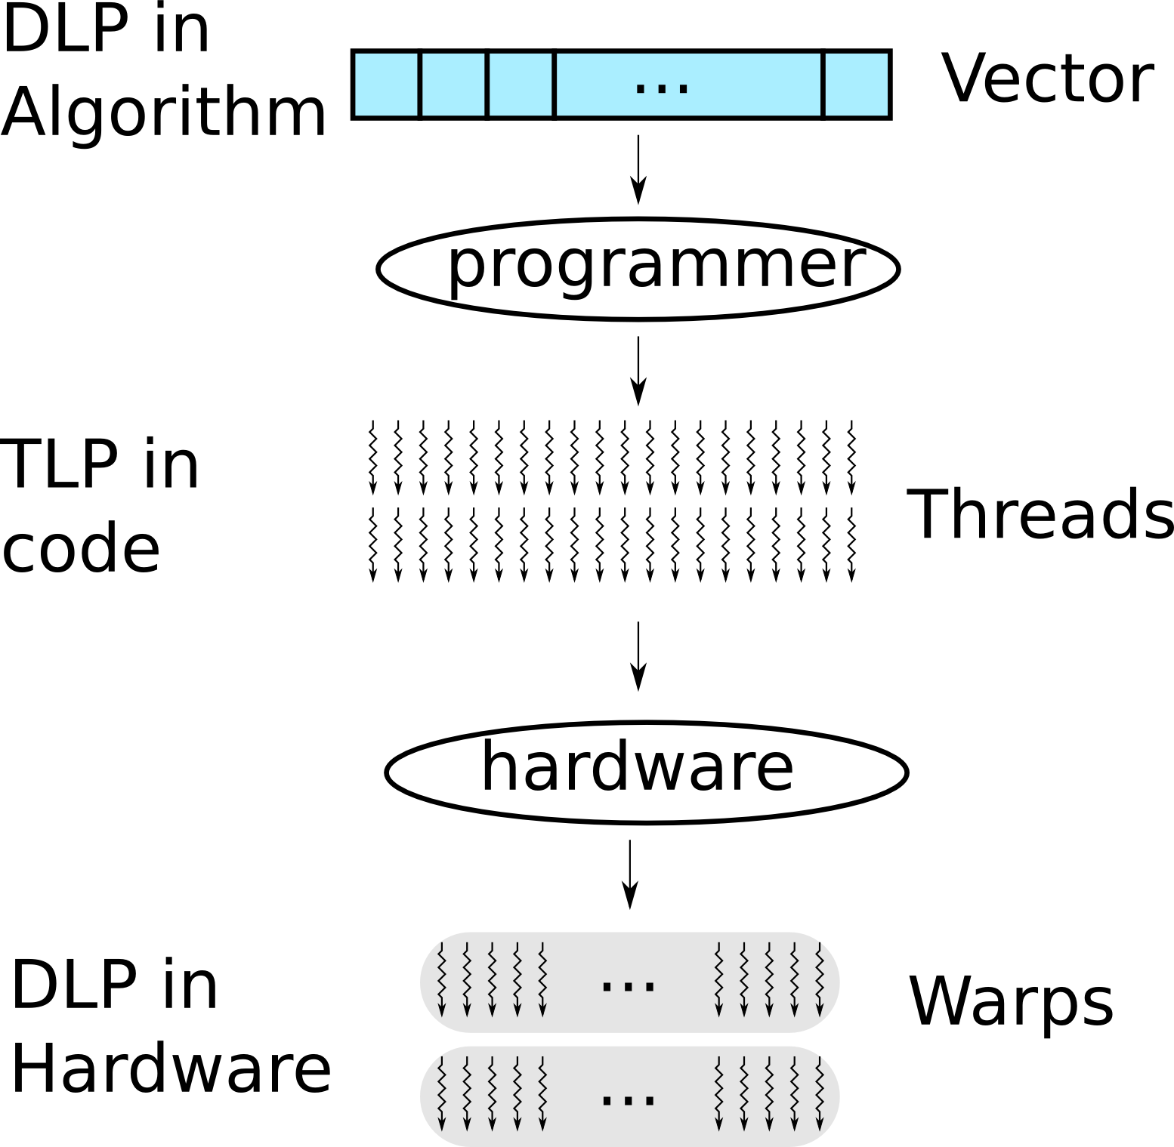
Review What We Have Learned
?
Programmers convert data level parallelism (DLP) into thread level parallelism (TLP).
Notes:
The application algorithm usually consists of data level parallelism (DPL). GPU programmers need to convert DPL into thread level parallelism (TLP) for the GPU programming model. On the GPU hardware, the TLP is dynamically converted into DPL. In Nvidia GPUs, 32 threads are grouped into a warp, which is scheduled for execution together.

Slide 54
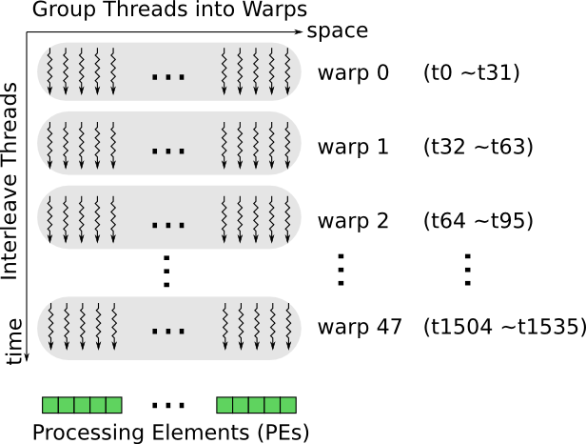
HW Groups Threads Into Warps
Example: 32 threads per warp
Notes:
Threads are grouped into warps, shown in the horizontal direction.
Warps are time-multiplexed on the PEs, shown in the vertical direction.

Slide 55
Execution of Threads and Warps
Let's start with an example.
Notes:
We will use an example to illustrate how a warp of threads executes on the PEs.

Slide 56
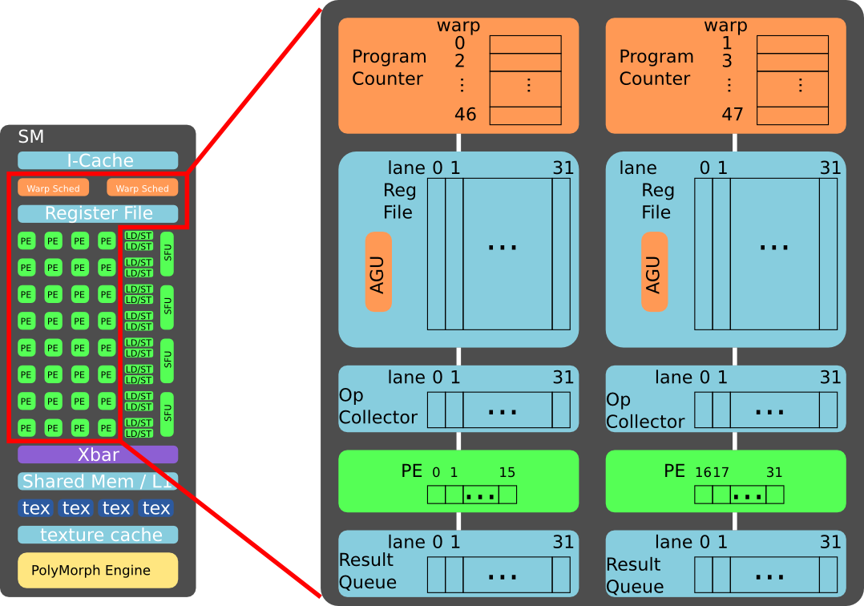
Example of Implementation
Note: NVIDIA may use a more complicated implementation.
See patent: US 8555035 B1
Notes:
This example assumes the two warp schedulers are decoupled. It is possible that they are coupled together, at the cost of hardware complexity.
There are several components:
Warp scheduler, with 46 program counters, each for a warp.
Register file, with 32 lanes, typically one read port and one write port per lane.
Operant collector, with 32 lanes, can have multiple read ports.
Processing elements, 16 PEs per 32 data lane.
Result queue, with 32 lanes.

Slide 57
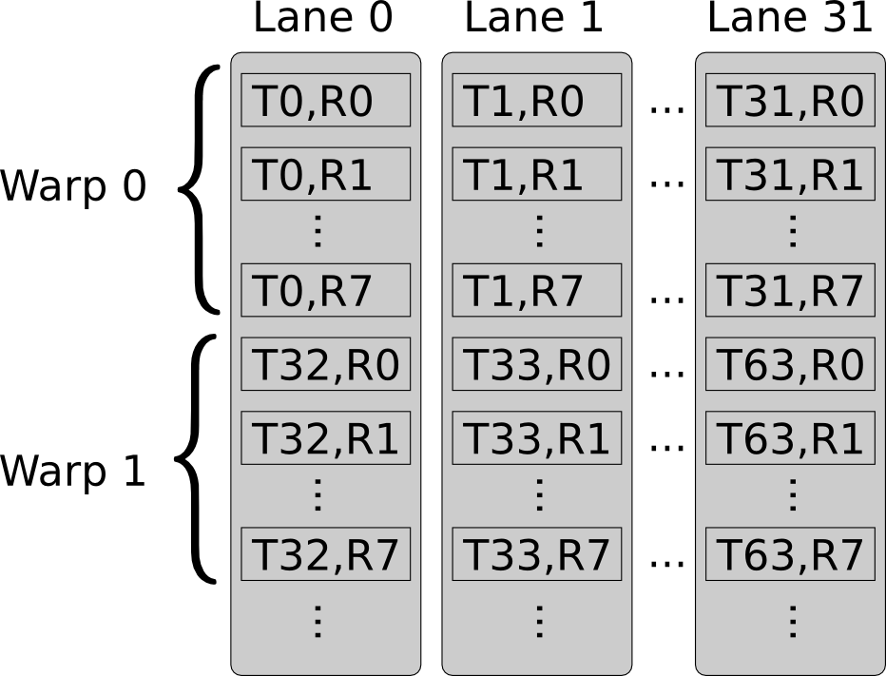
Example of Register Allocation
Assumption:
register file has 32 lanes
each warp has 32 threads
each thread uses 8 registers
Acronym:
“T”: thread number
“R”: register number
Note: NVIDIA may use a more complicated allocation method.
See patent: US 7634621 B1, “Register file allocation”.
Notes:
For the sake of simplicity, assume warp 0 and warp 1 are assigned to the same 32-lane register file, next to each other. In reality, warp 0 and warp 1 can be assigned differently, and to different register files.

Slide 58
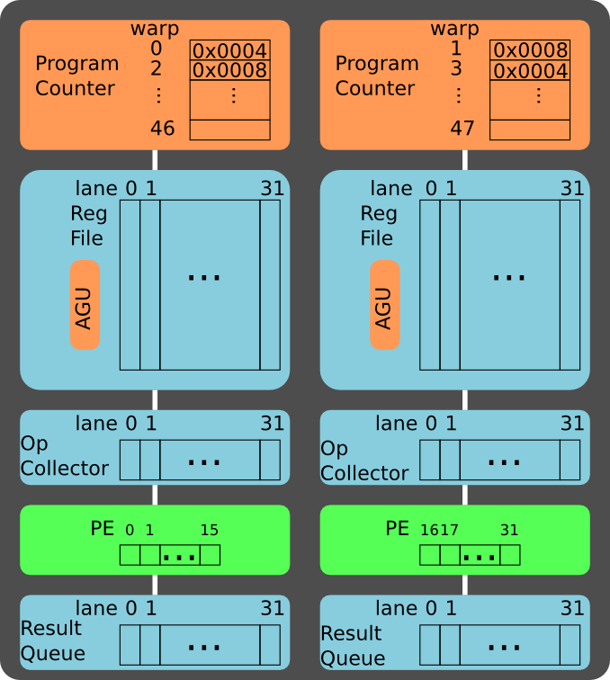
Example
Address : Instruction
0x0004 : add r0, r1, r2
0x0008 : sub r3, r4, r5
Assume:
two data paths
warp 0 on left data path
warp 1 on right data path
Acronyms:
“AGU”: address generation unit
“r”: register in a thread
“w”: warp number
Notes:
Example of two warps:
Warp 0 executes on the left data path with the instruction add r0, r1, r2
Warp 1 executes on the right data path with the instruction sub r3, r4, r5

Slide 59
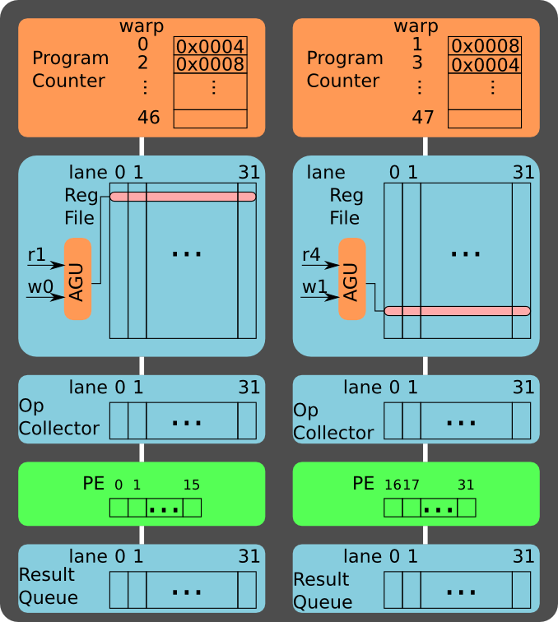
Read Src Op 1
Address : Instruction
0x0004 : add r0, r1, r2
0x0008 : sub r3, r4, r5
Read source operands:
r1 for warp 0
r4 for warp 1
Notes:
Assume the register file has one read port. In cycle 1, warp 0 reads r1, while warp 1 reads r4.
The address generation unit (AGU) maps the warp id and register id into the physical address.
The register file may need two read port to support instructions with 3 source operands, e.g. the Fused Multiply Add (FMA).

Slide 60
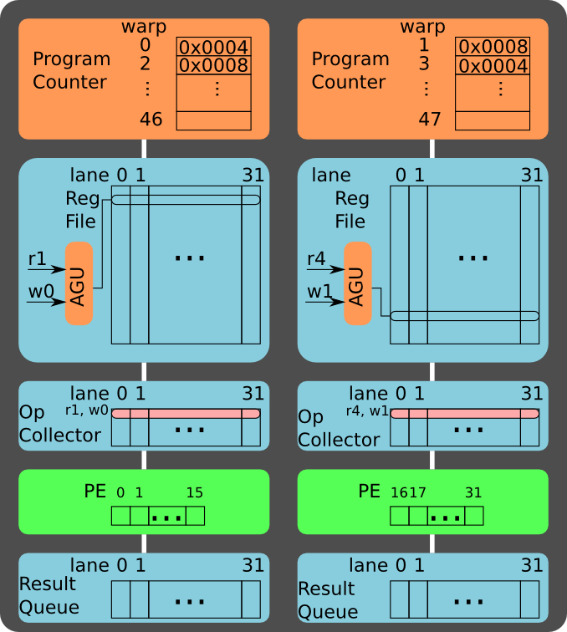
Buffer Src Op 1
Address : Instruction
0x0004 : add r0, r1, r2
0x0008 : sub r3, r4, r5
Push ops to op collector:
r1 for warp 0
r4 for warp 1
Notes:
The 32 register values of the warp (32 threads) are read out from the register file within a single cycle.
The PEs cannot execute the actual operation yet, because the second operand of the instruction (r2 for warp 0 and r5 for warp 1) is not yet available.
Therefore, the first operand needs to be store at a buffer, called operand collector. The operand collector is a buffer and is less deep than the register file. Therefore, the operand collector can afford multiple read ports.

Slide 61
Read Src Op 2
Address : Instruction
0x0004 : add r0, r1, r2
0x0008 : sub r3, r4, r5
Read source operands:
r2 for warp 0
r5 for warp 1
Notes:
In cycle 2, warp 0 reads r2, while warp 1 reads r5.

Slide 62
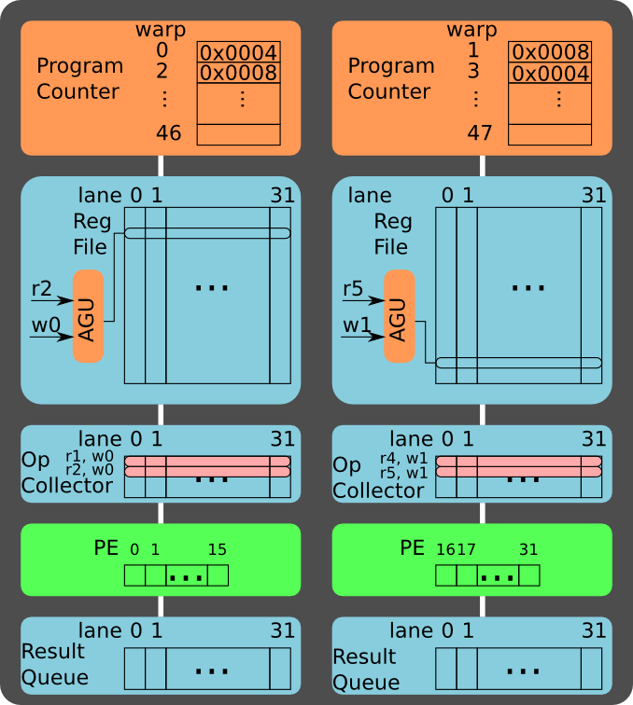
Buffer Src Op 2
Address : Instruction
0x0004 : add r0, r1, r2
0x0008 : sub r3, r4, r5
Push ops to op collector:
r2 for warp 0
r5 for warp 1
Notes:
The second operand is also pushed to the operand collector.

Slide 63
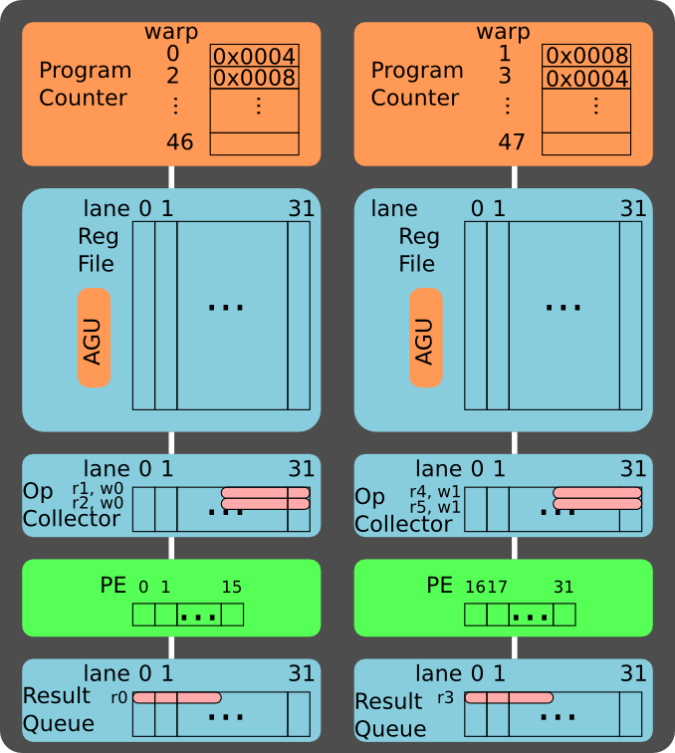
Execute Stage 1
Address : Instruction
0x0004 : add r0, r1, r2
0x0008 : sub r3, r4, r5
Compute the first 16 threads in the warp.
Notes:
Now both operands are available in the operand collector. Therefore, warp 0 can perform the “add”, and warp 1 can perform the “sub”.
There are 16 PEs for every 32-lane data path. Therefore, each warp execution is performed in two stages:
In the first stage, 16 PEs execute the first 16 threads of the 32-thread warp
In the second stage, 16 PEs execute the last 16 threads of the 32-thread warp
Note that now other warps can start their read out stage.
Question: Does it help if we use 32 PEs (instead of 16 PEs) for each 32-lane data path?
Answer: If we use 32 PEs (instead of 16 PEs) for each 32-lane data path, the execution is done in one cycle. However, the source operands are only available every two cycles (due to a single read port in the register file), the PEs will be idle every other cycle.

Slide 64
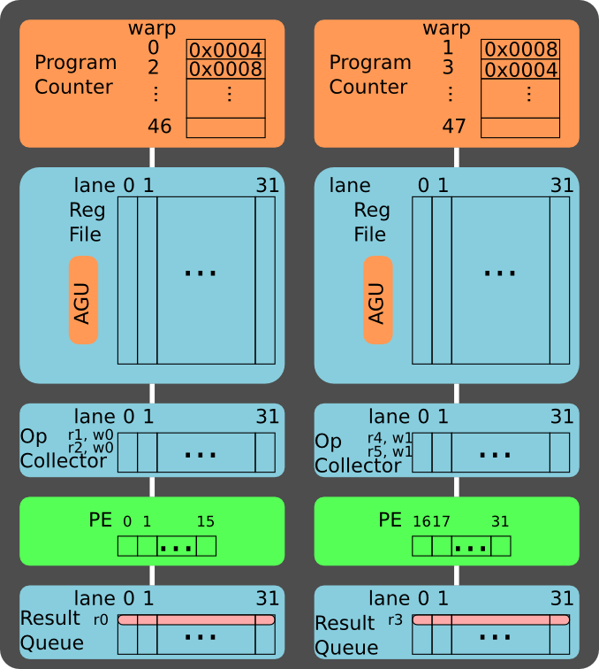
Execute Stage 2
Address : Instruction
0x0004 : add r0, r1, r2
0x0008 : sub r3, r4, r5
Compute the last 16 threads in the warp.
Notes:
The results of the two-stage are buffered into the result queue, waiting to be written back to the register file.

Slide 65
Write Back
Address : Instruction
0x0004 : add r0, r1, r2
0x0008 : sub r3, r4, r5
Write back:
r0 for warp 0
r3 for warp 1
Notes:
After the write back stage, the instruction retires. The program counter of the warp can be advanced.
In this example, there are only five stages in the execution pipeline. In the GPU, the pipeline can be as deep as 10 to 20 cycles, although the pipeline throughput can keep the PEs busy every cycle.

Slide 66
Recap
What we have learned so far:
Pros and cons of massive threading
How threads are executed on GPUs
Next: variations of GPU multiprocessor cluster.

Slide 67
NVIDIA Fermi (2009)
ref: http://www.nvidia.com/content/PDF/fermi_white_papers/NVIDIA_Fermi_Compute_Architecture_Whitepaper.pdf
Notes:
NVIDIA Fermi architecture can scale to 512 Cores, also called Processing Elements (PEs), although low-end versions are configured with less PEs.
In the context of this lecture, and related documents, these three terms are equivalent and interchangeable:
Processing Element (PE)
Stream Processor (SP)
Core

Slide 68
NVIDIA Kepler (2012)
ref: http://www.nvidia.com/object/nvidia-kepler.html
Notes:
Nvidia Kepler architecture scales to 2000+ cores (http://www.nvidia.com/object/tesla-servers.html). It resembles the previous generation, but packs more PEs into a cluster.
Here is a detailed review of the difference between Kepler and Fermi architecture:
http://www.anandtech.com/show/5699/nvidia-geforce-gtx-680-review/

Slide 69
NVIDIA Maxwell (2014)
ref: http://international.download.nvidia.com/geforce-com/international/pdfs/GeForce_GTX_980_Whitepaper_FINAL.PDF
Notes:
Nvidia Maxwell is focusing on energy efficiency. The PE cluster contains multiple partitions, within which threads are scheduled locally. It is beneficial for hardware complexity and energy efficiency.
White paper on NVIDIA Maxwell architecture:
http://international.download.nvidia.com/geforce-com/international/pdfs/GeForce_GTX_980_Whitepaper_FINAL.PDF
Here is a detailed review of the difference between Maxwell and Kepler architecture:
http://www.anandtech.com/show/5699/nvidia-geforce-gtx-680-review/

Slide 70
Variations of Multiprocessor Cluster
From Fermi to Kepler: More cores per cluster.
From Kepler to Maxwell: Partition cluster into sub-clusters.
Question: What are the Pros and Cons of these variations?
Notes:
From Fermi to Kepler:
Change: More cores per compute cluster.
Pros: Increase computation density.
Cons: Complexity of communication network. Pressure on instruction cache throughput.
From Kepler to Maxwell:
Change: Partition a cluster into sub-clusters.
Pros: Improve energy efficiency by eliminating complex network between sub-clusters.
Cons: Less area efficient. For example, each sub-cluster will need its own set of SFU and LD/ST unit.
References:
Comparison between Kepler and Fermi:
http://www.anandtech.com/show/5699/nvidia-geforce-gtx-680-review/
Comparison between Maxwell and Kepler:
http://www.anandtech.com/show/8526/nvidia-geforce-gtx-980-review/

Slide 71
What Are the Possible Hazards?
Three types of hazards we have learned earlier:
Structural hazards
Data hazards
Control hazards

Slide 72
Structural Hazards
In practice, structural hazards need to be handled dynamically.
Notes:
Assume the register file of MIPS has two read port and one write port. What would happen for a three-operand operation? Multiple issue? Instructions of different latency?

Slide 73
Data Hazards
In practice, we have a much longer pipeline.
Notes:
What happened when the pipeline is deeper? The Netburst went Netbust (https://en.wikipedia.org/wiki/Pentium_4).

Slide 74
Control Hazards
We cannot travel back in time. What should we do?
Notes:
CPUs typically uses branch predictors (https://en.wikipedia.org/wiki/Branch_predictor).
Can we play some better tricks? What if we can switch threads at zero cycle cost?

Slide 75
Additional Hazard: Mem Bank Conflicts
It is similar to structural hazard.
Example: 32 threads tries to perform load or store simultaneously to the 32-bank memory.

Slide 76
Shared Memory (compute capability 2.x)
Without
bank
conflict:
With
bank
conflict:
Programmers take the responsibility to eliminate bank conflicts.
Notes:
Reference on shared memory conflicts:
https://docs.nvidia.com/cuda/cuda-c-programming-guide/

Slide 77
Global Memory Access Coalescing
Example: 32 thread access the global memory (off-chip DRAM).
The memory transaction will load/store consecutive data at 32/64/128-Byte boundary.
Non-aligned access will cause additional memory transactions.
More examples in backup slides.
Notes:
Reference on global memory alignment:
https://docs.nvidia.com/cuda/cuda-c-programming-guide/

Slide 78
Additional Hazards: Branch Divergence
GPUs (and SIMDs in general) have additional challenges: branch divergence.
Notes:
What is some elements (threads) within a vector (warp) diverge at branch?

Slide 79
Let's Start Again from a simple CPU
Let's start from MIPS.

Slide 80
A Naive SIMD Processor
How to handle branch divergence within a vector?
Notes:
Copy and paste the data path and we have a naive SIMD processor. How should we handle branch?
Most SIMD execute both paths of a branch, masking out the part of the vectors accordingly.

Slide 81
Handling Branch In GPU
Threads within a warp are free to branch.
if( $r17 > $r19 ){
$r16 = $r20 + $r31
}
else{
$r16 = $r21 - $r32
}
$r18 = $r15 + $r16
Assembly code on the right are disassembled from cuda binary (cubin) using "decuda", link
Notes:
GPU handles branches more dynamically. Let’s play with an example.
At the branch (PC: 0x0012), the “else” path (label10) is pushed into a branch stack. The program first executes the “if” path, and then jump to the merge point (label11). At the merge point, the branch stack pops out the “else” path (label10).

Slide 82
If No Branch Divergence in a Warp
If threads within a warp take the same path, the other path will not be executed.
Notes:
If no thread takes the “else” path, there is no need to push the “else” path (label10) into the branch stack. Therefore, only the “if” path is executed.

Slide 83
Branch Divergence within a Warp
If threads within a warp diverge, both paths have to be executed.
Masks are set to filter out threads not executing on current path.
Notes:
If the threads within a warp indeed diverge, both paths of the branch are executed. Some PEs are idle in this case, because the data lanes cannot be rounded to arbitrary PEs dynamically.

Slide 84
Dynamic Warp Formation
Example: merge two divergent warps into a new warp if possible.
Create warp 3 from warp 0 and 1
Create warp 4 from warp 0 and 1
ref: Dynamic warp formation: Efficient MIMD control flow on SIMD graphics hardware. http://dx.doi.org/10.1145/1543753.1543756
Notes:
A more advanced technique is dynamic branch formation. If warp 0 and warp 1 both diverge at a branch, there are chances that threads can be re-organized into warps such that they can keep the PEs busy.

Slide 85
Recap SIMT Architecture
If no divergent branch, SIMT acts like interleaved threading SIMD. A vector of 32 data lanes has single program state.
At divergent branch, data lanes are assigned program states in a branch stack. SIMD becomes SIMT.
Classification of SIMT by Hennessy and Patterson
 | Static | Dynamic
ILP | VLIW | Superscalar
DLP | SIMD | SIMT

Slide 86
Elaborated Microarchitecture
Previous slides show a simplified architecture. Below is an elaborated example.
Ref: http://www.gpgpu-sim.org/
Notes:
The microarchitecture shown in this slide is modeled in the simulator GPGPU-Sim.
The explanation of the microarchitecture is provided in this slide:
http://www.gpgpu-sim.org/micro2012-tutorial/4-Microarchitecture.pptx
The GPGPU-Sim may not reflect the actual architecture implemented in Nvidia GPU, but they are considered quite similar.
A quick walk-over (details in the above slides):
The Fetch Unit holds the PC address of each warp.
The Scoreboard is bookkeeping the source and destination registers of an instruction, to resolve data hazard.
The I-Buffer can issue a thread if it is ready (r) according to the score board. After an instruction is issued, the slot become vacant (v) in the I-Buffer, and the Fetch Unit can fill the vacant entry with new instructions.
The SIMT Stack holds the contexts of a warp, including the PC, the return PC, and the per-thread mask for branch handling.
The Memory Unit will handle the memory access, and tries to resolve bank conflicts of shared memory and coalescing global memory access. It has Miss Status Holding Registers (MSHR) for bookkeeping outstanding memory transactions.

Slide 87
Performance Modeling
What are the bottlenecks?
Notes:
GPU programming does not have a steep learning curve. However, performance optimization is not trivial. First, we need to know what are the bottlenecks of the program.

Slide 88
Roofline Model
Performance bottleneck: computation bound v.s. bandwidth bound
Note the log-log scale.
Notes:
The Roofline model is a first-order model for bottleneck analysis:
http://dx.doi.org/10.1145/1498765.1498785
For the architecture, it takes peak performance and memory bandwidth into account.
For the algorithm, it take operational intensity (or computation to off-chip memory ratio) into account
The figure is taken from 8800 GPU. According to the analysis, if an algorithm has an operational intensity of 8 or higher, the algorithm will hit the peak performance of the GPU, which is computation bounded. If an algorithm has an operational intensity less than 8, the algorithm will hit the bandwidth limit, thus making it bandwidth bounded.

Slide 89
Optimization Is Key for Attainable Gflops/s
Notes:
In reality, it is difficult to reach the theoretical peak computational performance and the peak bandwidth. For example, if the off-chip memory is irregular, the effective bandwidth will be lower, which requires the algorithms to have a higher operational intensity to avoid being bandwidth bounded.

Slide 90
Computation, Bandwidth, Latency
Illustrating three bottlenecks in the Roofline model.
Notes:
The latency hiding is addressed in the PhD thesis of Samuel Williams.

Slide 91
Program Optimization
If I know the bottleneck, how to optimize?
Optimization techniques for NVIDIA GPUs:
"Best Practices Guide"
http://docs.nvidia.com/cuda/

Slide 92
Recap: What We have Learned
GPU architecture (SIMD v.s. SIMT)
GPU programming (vector v.s. thread)
Performance analysis (potential bottlenecks)

Slide 93
Further Reading
GPU architecture and programming:
NVIDIA Tesla: A unified graphics and computing architecture, in IEEE Micro 2008. (http://dx.doi.org/10.1109/MM.2008.31)
Scalable Parallel Programming with CUDA, in ACM Queue 2008. (http://dx.doi.org/10.1145/1365490.1365500)
Understanding throughput-oriented architectures, in Communications of the ACM 2010. (http://dx.doi.org/10.1145/1839676.1839694)

Slide 94
Recommended Reading (Optional)
Performance modeling:
Roofline: an insightful visual performance model for multicore architectures, in Communications of the ACM 2009. (http://dx.doi.org/10.1145/1498765.1498785)
Handling branch divergence in SIMT:
Dynamic warp formation: Efficient MIMD control flow on SIMD graphics hardware, in ACM Transactions on Architecture and Code Optimization 2009. (http://dx.doi.org/10.1145/1543753.1543756)

Slide 95
Thank You
Questions?
Disclaimer: The opinions expressed in this presentation are solely from the presenter, and do not express the views or opinions of his/her employer.

Slide 96
Backup Slides

Slide 97
Common Optimization Techniques
Optimizations on memory latency tolerance
Reduce register pressure
Reduce shared memory pressure
Optimizations on memory bandwidth
Global memory coalesce
Avoid shared memory bank conflicts
Grouping byte access
Avoid Partition camping
Optimizations on computation efficiency
Mul/Add balancing
Increase floating point proportion
Optimizations on operational intensity
Use tiled algorithm
Tuning thread granularity

Slide 98
Common Optimization Techniques
Optimizations on memory latency tolerance
Reduce register pressure
Reduce shared memory pressure
Optimizations on memory bandwidth
Global memory coalesce
Avoid shared memory bank conflicts
Grouping byte access
Avoid Partition camping
Optimizations on computation efficiency
Mul/Add balancing
Increase floating point proportion
Optimizations on operational intensity
Use tiled algorithm
Tuning thread granularity

Slide 99
Multiple Levels of Memory Hierarchy
Name | Cache? | Latency (cycle) | Read-only?
Global | L1/L2 | 200~400 (cache miss) | R/W
Shared | No | 1~3 | R/W
Constant | Yes | 1~3 | Read-only
Texture | Yes | ~100 | Read-only
Local | L1/L2 | 200~400 (cache miss) | R/W
Notes:
Numbers taken from an old paper on G80 architecture, but it should be similar to the GF100 architecture.

Slide 100
Shared Mem Contains Multiple Banks

Slide 101
Compute Capability
Need arch info to perform optimization.
ref: NVIDIA, "CUDA C Programming Guide", (link)

Slide 102
Shared Memory (compute capability 2.x)
without
bank
conflict:
with
bank
conflict:
Notes:
Reference on shared memory conflicts:
https://docs.nvidia.com/cuda/cuda-c-programming-guide/

Slide 103
Common Optimization Techniques
Optimizations on memory latency tolerance
Reduce register pressure
Reduce shared memory pressure
Optimizations on memory bandwidth
Global memory coalesce
Avoid shared memory bank conflicts
Grouping byte access
Avoid Partition camping
Optimizations on computation efficiency
Mul/Add balancing
Increase floating point proportion
Optimizations on operational intensity
Use tiled algorithm
Tuning thread granularity

Slide 104
Global Memory In Off-Chip DRAM
Address space is interleaved among multiple channels.

Slide 105
Global Memory

Slide 106
Global Memory

Slide 107
Global Memory

